Slide 1
Laboratory Diagnosis of Infectious disease
- Two features
Bacteriologic
Microscopy after staining
Obtaining a pure culture
Biochemical testing, DNA testing (PCR), agglutination, immunofluorescence
Antibiotic sensitivity testing
2. Immunologic- serology
- detection of antibodies against the organism in patient’s serum

Slide 2
The Specimen
The primary connection between the clinical encounter and diagnostic laboratory
Quality of specimen is important
- appropriate specimen
- obtaining it properly to avoid contamination from the normal flora
- transporting the specimen promptly to the laboratory
- providing essential information to guide the laboratory personnel

Slide 3
Specimen collection and Transport
Sterile swab
- Most convenient and most commonly used tool for specimen collection
- Transport: specimen should be transported to the laboratory as soon as possible
(N. gonorrhoeae, few min)
Transport media: buffered fluid or semisolid media containing minimal nutrients and are designed to prevent drying, maintain a neutral pH, minimize bacterial growth (free oxygen for obligate anaerobes)

Slide 4
Direct tissue or Fluid samples
Collected from
- sterile tissue (lung, liver)
- body fluids (CSF, blood)
Methods: Needle aspiration to surgical biopsy
Results: useful

Slide 5
Indirect Samples
Specimen of inflammatory exudates (expectorated sputum, voided urine)
Methods: more convenient for both physician and patient

Slide 6
Direct examination (microscopic)
Bacteria must be stained
Gram stain
Acid-fast stain

Slide 7
Gram stain vs Acid-fast stain
Staining
Decolorization
Counterstain
Gram-positive bacteria retain purple iodine-dye complexes
Gram-negative bacteria do not retain complexes when decolorized

Slide 8
Gram stain vs Acid-fast stain
Acid-fast organisms stain very poorly with dyes
Can be stained by prolonged application of more concentrated dyes, facilitated by heat treatment

Slide 9
Gram stain vs Acid-fast stain
Intact cell wall is necessary for positive reaction
Gram-positive bacteria may fail to retain the stain (old, dead, damaged by antimicrobial agents)

Slide 10
Culture
Growth and identification of the infecting agent in vitro is important
Culture is the most commonly used
Bacteria grow in soup-like media
Large number of bacteria in broth produce turbidity

Slide 11
Culture
Bacteria may be separated in isolated colonies on agar plates
Colonies may have consistent and characteristic features (size, shape, texture, color)
E. coli: flat colonies with irregular edges
Klebsiella pneumoniae: raised surface, smooth entire edges

Slide 12
Blood culture
Sepsis, endocarditis, osteomyeletis, meningitis or pneumonia
Gram +ve S. aureus, S. pneumoniae
Gram –ve E. coli, K. pneumoniae, Pseudomonas aeruginosa
+ve growth, gram stain, subculture, ATB sensitivity

Slide 13
Throat culture
Pharyngitis
(S. pyogenes)
Diphtheria, gonococcalpharyngitis
Candida (thrush)
Throat swab: inoculated on blood agar and gram stain is not done
24 incubation β- hemolytic streptococcus (group A, non-group A)

Slide 14
Sputum culture
Pneumoniae, tuberculosis
- community acquired pneumonia – Str. Pneumoniae
- hospital acquired pneumonia – Sta. aureus, Klebsiella pneumoniae, Pseudomonas aeruginosa
Gram stain smear (satisfactory specimen or not)
A reliable specimen has more than 25 leukocytes and fewer than 10 epithelial cells per 100X field
Culture on blood agar
Mycoplasma: rise in antibody titer
Legionella pneumophila: charcoal-yeast agar (high concentration iron sulfur)
Tuberculosis: acid-fast stain
Alternative specimen – Transtracheal aspirate, bronchial lavage, lung biopsy ( MORE RELIABLE)

Slide 15
Spinal fluid culture
Meningitis (causes)
CSF from encephalitis, brain abscess, subdural empyema show negative cultures
Gram stain of sediment of centrifuged CSF
Guide to empiric therapy
The most important cause of acute bacterial meningitis
Neisseria meningitidis
Str. Pneumoniae
Haemophilus influenzae
Cryptococcus neoformans Identified by India ink stain
Immunological tests detect capsular antigen
- latex particle agglutination
- counter-immunoelectrophoresis

Slide 16
CSF
Detection of capsular antigen in spinal fluid
Neisseria meningitidis
Str. Pneumoniae
- Haemophilus influenzae
- Group B streptococci
- E. coli
- Cryptococcus neoformans
By Latex agglutination, Counter immunoelectrophoresis

Slide 17
Stool culture
Enterocolitis
Shigella, Salmonella, Campylobacter, E. coli O157
Gram stain not done
Salmonella & Shigella
MacConkey, Eosin-methylene blue EMB
non lactose fermenting colonies: triple sugar iron (TSI)

Slide 18
Urine culture
Pyelonephritis, cystitis
E. coli
Proteus
Enterobacter
Enterococcus feacalis
Midstream urine
Culture within 1 hour (store in refrigerator at 4°C less than 18 h)
Alternative specimen
Suprapubic aspiration
Catheterization

Slide 19
Genital Tract Cultures
Abnormal discharge, sexually transmitted disease
Neisseria gonorrhoeae: microscopic examination of a Gram stained smear
Treponema pallidum: microscopy,serology

Slide 20
Wound & Abscess Cultures
Depend on anatomic site
Lung, brain, abdomen abscess
- anaerobes Bacteroides fragilis
- gram positive cocci Sta. aureus, Str. Pyogenes
Open wound infection- Clostridium perfringens
Surgical wound infections- Sta. aureus
Dog, cat bites – Pasteurella multocida
Human bites- mouth anaerobes Eikenella corodens
Place specimen in anaerobic collection tubes
Important to culture the specimen on several different media under different atmospheric condition
Usually mixtures of anaerobes and aerobes

Slide 21
Immunological methods
Capsular swelling:
Depend on homologus antisera against organisms
Microscopic swelling in the capsule
S. pnemoniae, H. influenzae type b

Slide 22
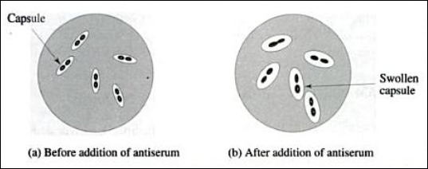

Slide 23
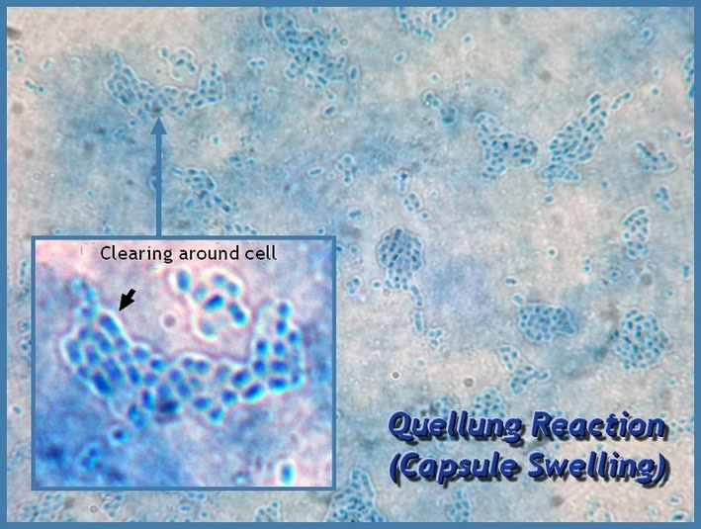

Slide 24
Immunological methods
Slide agglutination test
- Agglutination (clumping) of unknown organism
Antisera against
- Cell wall O antigen of Salmonella and Shigella
- Flagellar H antigen
- Capsular Vi antigen (salmonella)

Slide 26
Immunological methods
Latex agglutination test
Latex beads coated with antibody (agglutination
homolgous bacteria, antigen)
Capsular antigen H. influenzae, N. meningitidis

Slide 27
Antibody detection
Detection of antibody in patient’s serum
IgM antibogy indicates current infection
Four fold or greater rise in antibody titer
current infection- retrospective
One IgG titer ? Current or previous
Increase in the antibodies titer
- Typhoid fever
- brucellosis
- plague
- rickettsial diseases
Serologic Tests for Syphilis
Cold Agglutinin test

Slide 28
Nucleic Acid-based Methods
Nucleic acid amplification: using PCR for amplification of bacteria specific DNA
Nucleic acid probe: detect bacteria DNA or RNA directly using a labeled DNA or RNA probe
Nucleic acid sequence: identify bacteria based on the base sequence of the organism’s ribosomal RNA

Slide 29
