Slide 1
Preparation of bacteriologic media
Need for culture media:
Bacteria: mixed population in nature, by appropriate procedures they have to be grown separately
Medium: nutrients, support growth

Slide 2
Agar
Universally used for preparing solid medium
Obtained from seaweed: Gelidium
Not affected by the growth of the bacteria
Melts at 98c & sets at 42c
2% agar is employed in solid medium

Slide 3
Types of culture media
Based on their consistency
Solid, liquid, semi solid
Based on the ingredients:
Simple medium
Complex medium
Special medium
Synthetic medium

Slide 4
Types of culture media
Based on Oxygen requirement:
Aerobic media
Anaerobic media

Slide 5
Types of culture media
Solid media: contains 2% agar, colony morphology, pigmentatiom, hemolysis can be appreciated
Liquid media: no agar, for inoculum preperation, eg (Nutrient broth)
Semi solid medium: 0.5% agar, eg (Motility medium)

Slide 6
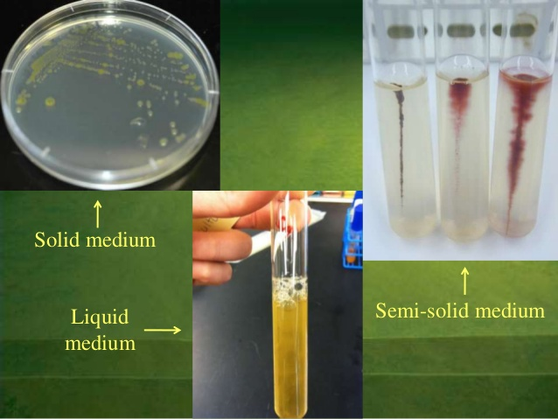

Slide 7
Simple media/ basal media
Most common in routine diagnostic laboratories ( Nutrient Agar)
NB consiss of peptone, meat extract, water, NaCl
NB + 0.5% Glucose= Glucose broth
NB + 2% agar = Nutrient Agar
Agar conc ( 0.2%-0.5%)= semi solid medium

Slide 8
Types of culture media
Complex media:
Provide special nutrients
they have added complex ingredients such as yeast extract
consist of a mixture of many chemical species

Slide 9
Types of culture media
Synthetic media:
Prepared from pure chemical substances
Exact composition is known
Used for special studies, eg ( metabolic requirements)
Peptone water

Slide 12
Enrichment media
Used to isolate pathogens from mixed culture
Stimulate growth of desired bacterium
Media is incorporated with inhibitory substances to suppress the unwanted organism

Slide 13
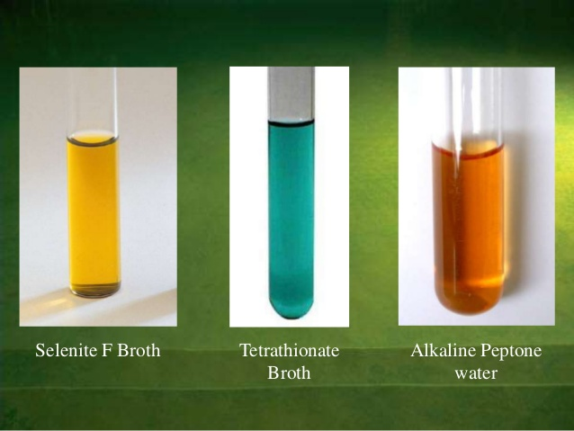

Slide 14
Selective media: the inhibitory substance is added to solid media increase in number of desired bacterium

Slide 15
Mac Conkey Agar
Contains crystal violet & bile salts to inhibit Gram +ve bacteria, lactose & a pH indicator (neutral red) to determine ability to ferment lactose

Slide 16
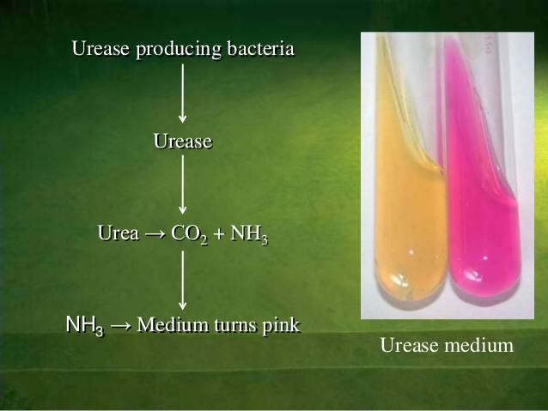
Indicator media

Slide 17
Differential media

Slide 18
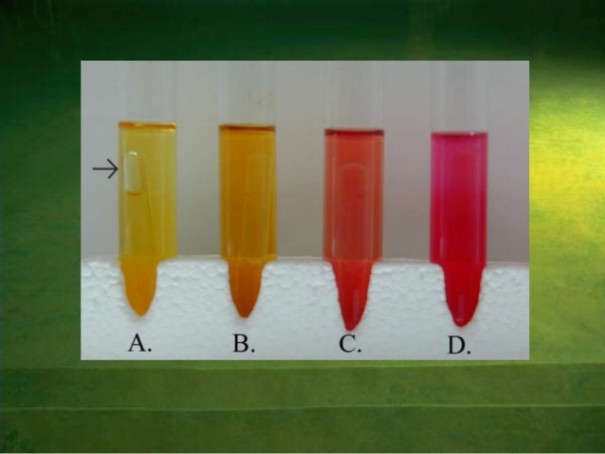
Sugar media: Containing any fermentable substances

Slide 19
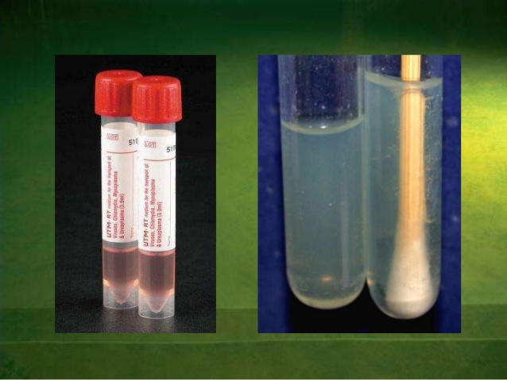
Transport media (Buffered glycerol saline)

Slide 20
Culture methods include
Streak culture
Lawn culture
Stroke culture
Stab culture
Pour plate culture
Liquid culture
Anaerobic culture

Slide 22
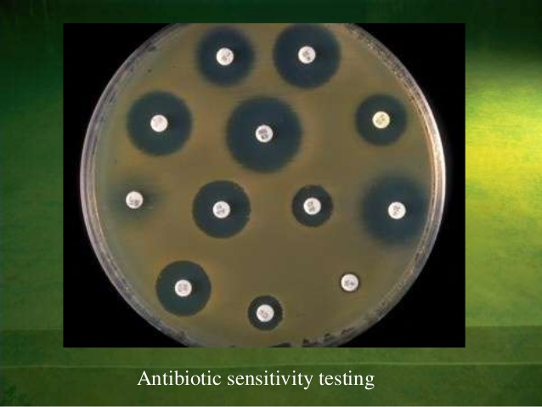
Lawn culture

Slide 23
Anaerobic culture methods
Production of a vacuum
Displacement of oxygen with other gases
Chemical method
Biological method
Reduction of medium

