Slide 1
Antibacterial drugs mechanism of action

Slide 2
Antimicrobial drug stewardship
Discovery of antimicrobials, great advances in medicine
Problem is emergence of multidrug resistant organisms
Reduced efficacy of most powerful antimicrobials
Adverse effects of antimicrobials e.g. Clostridium difficile colitis

Slide 3
Antimicrobial drug stewardship
CDC reports > 2million infections with MDR/year..leading to approximately 20,000 deaths.
MRSA
Extended spectrum beta lactamase Enterobacteriaceae (ESBL)(E. coli, Kelbsiella pneumoniae)
Hospital acquired infections caused by resistant bacteria cost billions of dollars each year.

Slide 4
Basic principles of antimicrobial stewardship
1. Reduce inappropriate use of antibiotics
Use only when indicated
Emperic therapy tailored to the most likely pathogen
Send for appropriate cultures before starting antibiotics
2. Encourage targeted treatment with narrow spectrum drugs

Slide 5
Basic principles of antimicrobial stewardship
3. Limit adverse effects
- Stop as soon as appropriate
Aware of the patient’s renal function on the dose of antibiotic used
Be aware of the patient’s hypersensitivity to specific antibiotics
Determine if the patient’s declared HST is correct
Warn the patient against idiosyncratic reactions such as photosensitivity

Slide 6
Principles of antimicrobial therapy
Selective toxicity
Four major sites in the bacterial cell sufficiently different from the human cell
Cell wall
Ribosomes
Nucleic acids
Cell membrane

Slide 7
Objectives
Historical background
Definitions
Antimicrobials
Antibiotics
Chemotherapeutic agents
Bacteriostatic antibiotics
Bactericidal antibiotics
Minimum inhibitory concentration MIC
Minimum bactericidal concentration MBC
Synergistic antibiotics

Slide 8
Objectives
Antagonistic antibiotics
Empiric therapy
Prophylactic treatment
Broad spectrum
Narrow spectrum
Desirable properties of antibiotics
Dangers of indiscriminate use of antibiotics
Resistance to antimicrobial agents
Transmitting resistance from a bacterium to another bacterium

Slide 9
Historical background
1922 Fleming discovered Penicillium notatum
1929 Penicillin was discovered
1940 penicillin was available for clinical use
“ Chance favors the prepared mind” Louis Pasteur
It was the first and still the best

Slide 10
Antimicrobial agents
Definition
Chemotherapeutic agents
Antimicrobials
Antibiotics

Slide 11
Bacteriostatic antibiotics
e.g. tetracycline, ethambutol
Bactericidal antibiotics
e.g. Penicillin, aminoglycosides, and quinolone antibiotics
life threatening conditions, e.g. acute bacterial endocarditis.
Compromised immune system, e.g. when PMN count is less than 500/ul

Slide 12
Minimum Inhibitory Concentration MIC
Minimum Bactericidal Concentration MBC

Slide 13
MIC or tube dilution method

Slide 14
MIC or tube dilution method

Slide 15
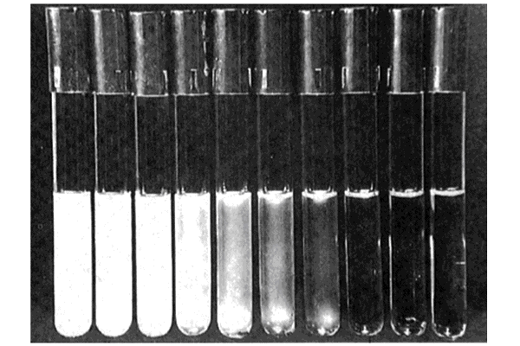
Minimum Inhibitory Concentration

Slide 16
Definitions
Synergistic antibiotics: e.g.
a penicillin, clindamycin or vancomycin WITH aminoglycosides or aztreonam.
trimethoprim WITH sulphamethoxazol
Antagonistic antibiotics
Penicillin G combined with the bacteriostatic tetracycline to treat meningitis caused by Streptococcus pneumoniae
Penicillin G is bactericidal but requires an actively growing bacterial population
Empiric therapy
is an educated guess therapy, when there is no information about the causative agent

Slide 17
Prophylactic antibiotic
To prevent diseases from occurring
Prior to surgery
In immunocompromised patients
In normal people who have been exposed to certain pathogens

Slide 18
Broad spectrum
e.g. tetracycline. Some are also active against anaerobes, e.g. Chloramphenicol, and imepenim.
Narrow spectrum
e.g. vancomycin, and aztreonam
some are specific for an organism per se. e.g. isoniazid against Mycobacterium tuberculosis

Slide 19
Desirable properties of antibiotics
Selective toxicity
Bactericidal rather than bacteriostatic
Hard to develop resistance against
Narrow spectrum of activity
Minimal adverse effects
Water soluble and stable
Long plasma action
Good tissue distribution including CSF
Low plasma protein binding

Slide 20
Rapidly achieve therapeutic levels in plasma, body fluids and tissues
Oral and parenteral dosing forms
Has minimal drug interactions
Wide therapeutic index, the lethal dose is much higher than the therapeutic dose

Slide 21
Dangers of indiscriminate use of antibiotics
Allergic reaction, e.g. penicillin allergy
Direct toxicity, e.g. BM suppression with chloramphenicol
Alteration of NF
Masking but not treating a serious disease like an abscess
Development of drug resistance

Slide 22
The S. aureus story
1941
Penicillin
1961
Penicillinase-stable
Penicillins(Methicillin)
Glycopeptide
(Vanocomycin)
2004
90% resistance
by penicillinase
2004
Up to 60% resistance
(MRSA)
2002-2004
3 cases of Vanco
Resistance(VRSA)!

Slide 23
Resistance to antimicrobial agents
Enzyme mediated, used against penicillin, and amino glycosides
Altering permeability, used against tetracycline
Altering target sites, used against amino glycosides and penicillin “MRSA”
Altering a metabolic pathway, used against sulpha drugs
Altering the enzyme so that it is still active even in the presence of the drug e.g .resistance to sulfa drugs

Slide 24
Mechanisms of antibiotic resistance

Slide 25
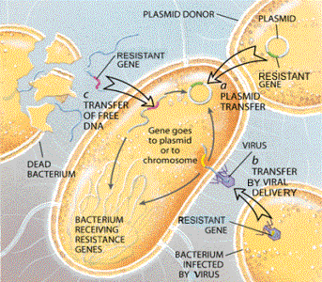
Transmitting resistance from a bacterium to another bacterium

