Slide 1
Quinolones &
Folic Acid Antagonists

Slide 2
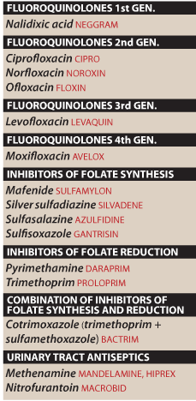

Slide 3
Quinolones
First quinolone, naladixic acid, was a byproduct of chloroquine synthesis (an antimalarial drug)
Current drugs are fluorinated 4-quinolones (Fluoroquinolones)
Effect on Microbes
spectrum of coverage
  1. Broad (both G+ and G-)
  2. Newer fluoroquinolones work against anaerobes

Slide 4
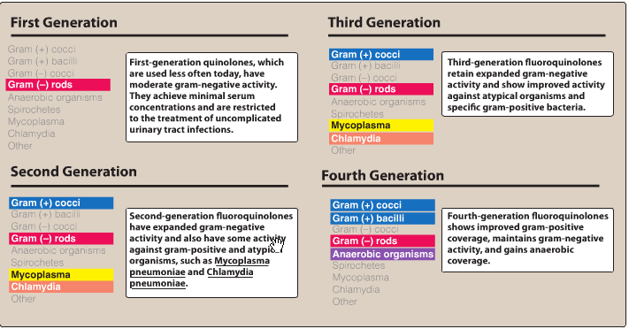

Slide 5
Mechanism of action
  Targets are DNA gyrase (topoisomerase II) (for G-) and topoisomerase IV (for G+)
  Inhibition of gyrase prevents negative supercoiling in replicating DNA
  Inhibition of topoisomerase IV prevents separation DNA strands
Mechanism of resistance
  1. mutations in chromosomal genes for gyrase and topoisomerase IV that result in proteins with less binding potential
  2. active transport out of cell with efflux pumps

Slide 6
Pharmacokinetics of Quinolones
A. absorbance
1. Well absorbed after oral administration
2. Food does not impair absorption but it might delay time to peak serum concentrations
B. Fate after absorption
Bioavailability of fluoroquinolones is more than 50% for all agents (95% for some)

Slide 7
C. Excretion
  Most are cleared by the kidney so adjust dosage for renal patients
  Exceptions are pefloxacin and moxifloxacin which are metabolized by the liver; do not use in patients with hepatic failure

Slide 8
Pharmacology of Select Quinolones
Ciprofoxacin: 2nd
Ciprofoxacin is particularly useful in treating infections caused by many Enterobacteriaceae and other gram-negative bacilli. For example, traveler’s diarrhea
Not effective against serious infections caused by MRSA, the enterococci, and pneumococci.

Slide 9
Ciprofoxacin: 2nd generation
It is the most potent of the fuoroquinolones for Pseudomonas aeruginosa
The drug is also used as an alternative to more toxic drugs, such as the aminoglycosides.
It may act synergistically with β-lactams and is also of benefit in treating resistant tuberculosis.

Slide 10
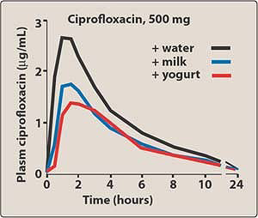
Ciprofloxacin-food interactions

Slide 11
3. Levofloxacin: 3rd
Is a broad spectrum
It can be used in the treatment of prostatitis due to E. coli and of STDs.
It may be used in patients with gonorrhea.
Utilized in a wide range of infections, including: skin infections, pneumonia & S. pneumoniae respiratory infections

Slide 12
4. Moxifloxacin: 4th
  Has enhanced activity against G+ organisms (for example, S. pneumoniae)
  Has excellent activity against many anaerobes.
  It has very poor activity against P. aeruginosa.

Slide 13
Therapeutic Uses of quinolones
A. Urinary tract infections
B. Prostatitis
STD’s
Gastrointestinal and abdominal infections
Respiratory tract infections
Bone, joint, and soft tissue infections

Slide 14
Toxicity/Contraindications
A. Nausea, vomiting and abdominal discomfort (common)
B. Diarrhea and antibiotic-associated colitis (uncommon to rare)
C. CNS side effects: mild headache and dizziness (common to rare)
D. Arthropathy in immature animals (common)
1. Quinolones must NOT be given to children usually
2. If benefit outweighs risk, then OK

Slide 15
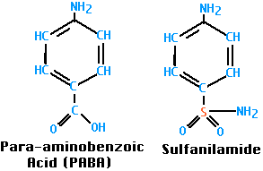
Sulfonamides
A. sulfonamide – generic term for derivatives of para-aminobenzenesulfonamide
B. analogues of para-aminobenzoic acid
C. sodium salts are water soluble

Slide 16
Effect on Microbes
A. spectrum of coverage – broad (both G+ and G-)
B. mechanism of action
1. competitive inhibitors of dihydropteroate synthase
2. bacteria cannot synthesize their own folic acid
3. bacteriostatic in most tissues, can be cidal in urine

Slide 17
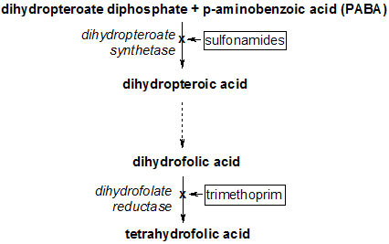

Slide 18
Pharmacokinetics of the Sulfonamides
A. Absorbance
  70-100% of an oral dose is absorbed from the gastrointestinal tract (mostly from small intestine, but also from stomach)
B. Fate after absorption
  2. distributed throughout all tissues of the body
  3. readily cross the placenta and reach fetal circulation ( … are contraindicated in pregnancy)

Slide 19
C. Excretion
  eliminated mostly by the kidneys into the urine, partially unchanged, partially metabolized
  some drugs become insoluble in acid urine and may precipitate

Slide 20
Classes of Sulfonamides:
Rapidly absorbed and eliminated sulfonamides (sulfisoxazole, sulfamethoxazole, sulfadiazine)
  sulfamethoxazole combined with trimethoprim is widely used to treat: UTI, RTIs, & GI infections

Slide 21
B. Poorly absorbed sulfonamides (sulfasalazine)
  1. poorly absorbed in GI tract
  2. used to treat ulcerative colitis, irritable bowel syndrome
  3. gut bacteria break down drug into sulfapyridine and 5-aminosalicylate
  4. toxicity due to sulfapyridine, therapeutic action due to 5-aminosalicylate
C. Sulfonamides for topical use
(sulfacetamide and silver sulfadiazine)

Slide 22
Toxicity/Contraindications
urinary tract
sulfamethoxazole and sulfadiazine can crystallize in acid urine or in dehydrated patients causing urinary obstructions
B. hematopoietic system (rare to extremely rare)
  acute hemolytic anemia – associated with deficiency of glucose-6-phosphate dehydrogenase activity in RBC
  agranulocytosis
  aplastic anemia
  C. hypersensitivity reactions (common to uncommon)

Slide 23
CO-TRIMOXAZOLE
The combination of trimethoprim with sulfamethoxazole, called co-trimoxazole, shows greater antimicrobial activity than equivalent quantities of either drug used alone .
The combination was selected because of their synergistic activity and the similarity in the half-lives of the two drugs.

Slide 24
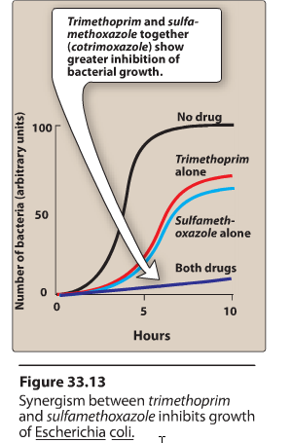

Slide 25
Resistance
Resistance to the trimethoprim-sulfamethoxazole combination is less frequently encountered than resistance to either of the drugs alone, because it would require that the bacterium have simultaneous resistance to both drugs.

Slide 26
Urinary Tract Antiseptics/Antimicrobials
UTIs are the most common problems seen by primary care physicians.
  Escherichia coli : 80% of uncomplicated upper and lower UTIs.
  Staphylococcus saprophyticus: second most common
  Others

Slide 27
Anti-fungal agents
Fungal infections to a large extent are iatrogenic in nature.
Fungal infections are associated with the use of broad spectrum antibiotic, indwelling catheters, AIDS.
Eukaryotic nature of fungus – resembling human cell makes it difficult treat.

Slide 28
Drugs for Subcutaneous / Systemic Fungal infections
Polyene drugs
  Amphotericin B
Echinocandins
Caspofungin, micafungin, and anidulafungin
Pyrimidine antimetabolites
Flucytosine
Azoles
  Ketoconazole, Fluconazole, Itraconazole, Voriconazole, Posaconazole

Slide 29
Drugs for Cutaneous Mycotic Infections
Systemic drugs
Terbinafine
Griseofulvin
Topical drugs
a polyene: Nystatin
Azoles: (miconazole, econazole, butaconazole, clotrimazole)
Terbinafine

Slide 30
Drugs for Subcutaneous / Systemic Fungal infections

Slide 31
Amphotericin B
It is obtained from streptomyces nodosus.
Mechanism of action :
It has affinity for ergosterol present in the cell membrane and forms a micropore thus disrupt the membrane function and cell death.

Slide 32
Adverse effects Amphotericin B
Amphotericin B has a low therapeutic index
INFUSION-RELATED TOXICITY
CUMULATIVE TOXICITY
Long term - Nephrotoxicity, anemia, CNS toxicity

Slide 33
Azoles
Mainly fungistatic in nature
  Ketoconazole
  Fluconazole
  Itraconazole
  Voriconazole
  Posaconazole
  Clotrimazole: Cutaneous
  Econazole: Cutaneous
  Miconazole: Cutaneous

Slide 34
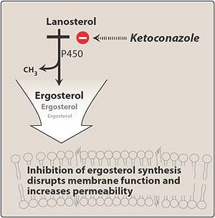

Slide 35
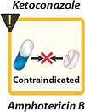
Ketoconazole and amphotericin B should not be used together, because the decrease in ergosterol in the fungal membrane reduces the fungicidal action of amphotericin B

Slide 36
Echinocandins:
Caspofungin, micafungin, and anidulafungin
Caspofungin
  is the first approved of Echinocandins
  It interferes with the synthesis of fungal cell wall by inhibiting the synthesis of beta ( 1,3 ) D – glucan, leading to cell lysis.
  Specific for aspergillus and Candida.
  Available for intravenous use only.

Slide 37
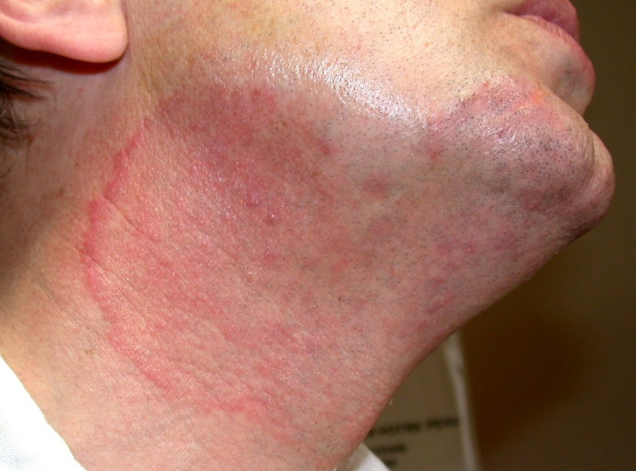
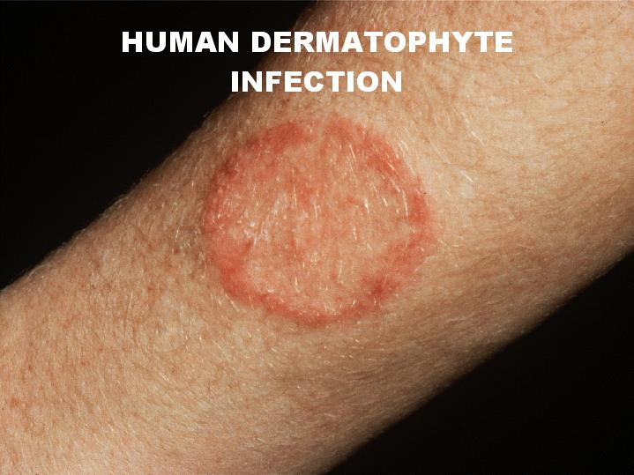
Drugs for Cutaneous Mycotic Infections
Fungi that cause superficial skin infections are called dermatophytes.

Slide 38
Terbinafine
Terbinafine: Fungicidal
Active against:
  Dermatophytes
  Candidiasis
MOA: It acts as a non competitive inhibitor of squalene epoxidase – in the ergosterol synthesis

Slide 40
Griseofulvin
It is obtained from penicillium griseofulvum
It is active against Dermatophytes

Slide 41
Nystatin
polyene antifungal drug
Binds to ergosterol, forms pores in the membrane that lead to K+ leakage and death of the fungus
It is very toxic when given systemically and used only for local anti-fungal effect
It is not absorbed orally
Used only for oral candidiasis - locally

Slide 42
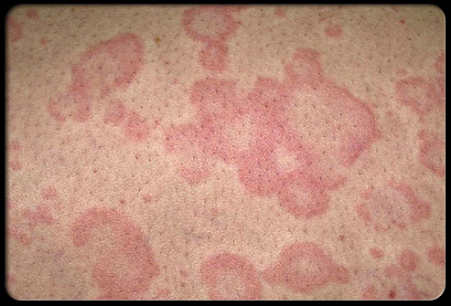
Other Azoles
Clotrimazole:
Effective for topical treatment of:
  tinea infections
  oral, vaginal and cutaneous candidiasis
Miconazole:
effective for:
  Tinea
  pityriasis Versicolor
  candidiasis
pityriasis Versicolor

Slide 43
Antiviral Agents

Slide 44
Viruses
Obligate intracellular parasites
Consist of a core genome in a protein shell and some are surrounded by a lipoprotein
lack a cell wall and cell membrane
do not carry out metabolic processes
Replication depends on the host cell machinery

Slide 45
Viruses
Steps for Viral Replication
  1) adsorption and penetration into cell
  2) uncoating of viral nucleic acid
  3) synthesis of regulatory proteins
  4) synthesis of RNA or DNA
  5) synthesis of structural proteins
  6) assembly of viral particles
  7) release from host cell

Slide 46
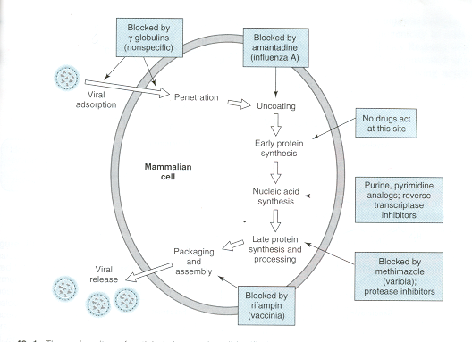
Sites of Drug Action

Slide 47
Antiviral Agents
Block viral entry into the cell or must work inside the cell
Most agents are pyrimidine or purine nucleoside analogs

Slide 48
Antiherpes Agents
Acyclovir- prototype
Valacyclovir
Famciclovir
Penciclovir
Trifluridine
Vidarabine

Slide 49
Mechanism of Action
Acyclovir
Aciclovir is converted by viral thymidine kinase to aciclovir monophosphate
Which is then converted by host cell kinases to aciclovir triphosphate (ACV-TP).
ACV-TP, in turn, competitively inhibits and inactivates DNA polymerases and incorporates itself into viral DNA chain

Slide 50
Clinical Uses , Acyclovir
Oral, IV, and Topical formulations
Cleared by glomerular filtration and tubular secretion
Uses:
  Herpes Simplex Virus 1 and 2 (HSV)
  Varicella-zoster virus (VZV)
Side Effects: nausea, diarrhea, headache, tremors, and delirium

Slide 51
Anti-Cytomegalovirus (CMV) Agents
Gancyclovir
Valgancyclovir
Cidofovir
Foscarnet
Fomivirsen

Slide 52
Antiretroviral Agents
There are five classes of antiretroviral drugs, each of which targets one of four viral processes. These classes of drugs are:
Nucleoside and nucleotide reverse transcriptase inhibitors (NRTIs),
Non-nucleoside reverse transcriptase inhibitors (NNRTIs),
Protease inhibitors,
Entry inhibitors
Integrase inhibitors.

Slide 53
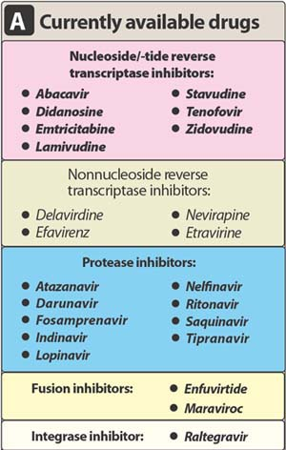

Slide 54
Anti-Hepatitis Agents
Lamivudine -Nucleoside Reverse Transcriptase Inhibitor (NRTI)
Adefovir -Nucleotide Inhibitor
Interferon Alfa
Pegylated Interferon Alfa
Ribavirin

Slide 55
Anti-Influenza Agents
Amantadine and Rimantadine
  inhibit the uncoating of viral RNA therefore inhibiting replication
  used in the prevention and treatment of Influenza A
Zanamivir and Oseltamivir
Inhibits the enzyme neuraminidase
inhibit the replication of influenza A and Influenza B
treats uncomplicated influenza infections
administered intranasally

