Slide 1
Protein Synthesis Inhibitors
Tetracyclines
Glycylcyclines
Aminoglycosides
Microlides/Ketolides
Others

Slide 2
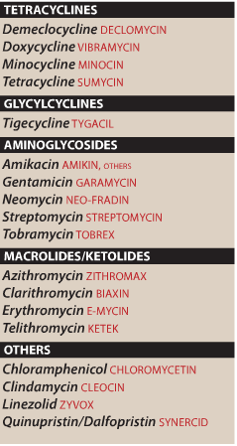

Slide 3
Protein Synthesis Inhibitors
Targeting the bacterial ribosome, which has components that differ structurally from those of the mammalian cytoplasmic ribosome.
The bacterial ribosome:
is smaller (70S) than the mammalian ribosome (80S)
composed of 50S and 30S subunits
Mammalian ribosomes
80S
Composed of 60S and 40S subunits.
60
40
80S ribosome
(human)

Slide 4
I. TETRACYCLINES
Effect on Microbes
Spectrum of coverage – broad spectrum
1. more effective against G+ than G-
work against:
Anaerobes
Intracellular bacteria
Atypical bacteria (Mycoplasma, Ureaplasma, etc)

Slide 5
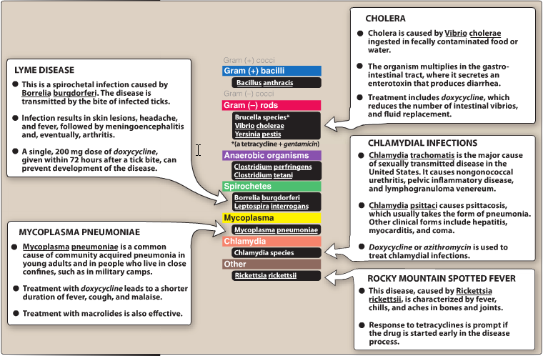

Slide 6
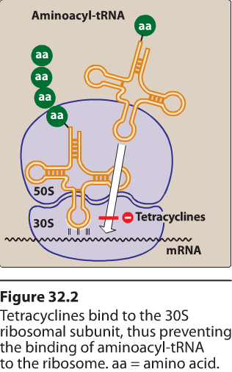
Mechanism of action:
Inhibit protein synthesis by reversibly binding to ribosome
Bacteriostatic

Slide 7
Mechanism(s) of resistance
Decreased influx or active efflux
Production of a ribosomal protection protein
Enzymatic inactivation

Slide 8
Pharmacokinetics of Tetracyclines
A. Absorption
oral absorption is incomplete, depends on particular agent
can be given orally or parenterally
occurs mostly in an empty stomach and upper small intestine
interference with intake of dairy products, antacids, and dietary iron and zinc supplements (divalent and trivalent cations chelate)

Slide 9
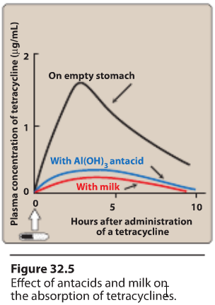

Slide 10
B. Fate after absorption
widely distributed throughout the body into tissues and secretions
accumulates in liver, spleen, bone marrow, bone, dentine and enamel of unerupted teeth
crosses placenta and enters fetal circulation, found in breast milk
C. Excretion
1. for the most part, excreted by kidney
2. also concentrated into bile and excreted

Slide 11
Tetracyclines - drug list
A. tetracycline, oxytetracycline, demeclocycline
absorption -
incompletely absorbed from stomach (60-80%)
excretion - kidneys
B. minocycline, doxycycline
Absorption
completely absorbed from stomach (95-100%)
excretion - liver

Slide 12
Therapeutic Uses of Tetracyclines
A. Rickettsial infections
B. Mycoplasma infections – atypical pneumonia
C. Chlamydia infections

Slide 13
Toxicity/Contraindications (all uncommon to common)
A. gastrointestinal
epigastric burning and distress, nausea, vomiting, diarrhea
B. photosensitivity
mild to severe reactions to sunlight
C. hepatic toxicity
associated with large doses
D. renal toxicity
aggravate azotemia in renal patients
E. discoloration of teeth
1. brown discoloration of teeth in children due to deposition of drug in dentine and tooth enamel
2. should NOT be given to pregnant women for this reason

Slide 14
Glycylcyclines
Tigecycline
is the first available member.
a derivative of minocycline.
Tigecycline is indicated for treatment of complicated skin and soft tissue infections
Resistance
Tigecycline was developed to overcome the recent emergence of tetracycline class resistant organisms that utilize efflux and ribosomal protection to infer resistance.

Slide 15
II. Aminoglycosides
The mainstays for treatment of serious infections due to aerobic gram-negative bacilli.
However, because their use is associated with serious toxicities, they have been replaced to some extent by safer antibiotics, such as:
the third- and fourth-generation cephalosporins
the fluoroquinolones
the carbapenems.

Slide 16
Effect on Microbes
Spectrum of coverage - narrow
1. work against G- aerobic bacteria
2. work against G+ cocci, if combined with a beta-lactam (synergistic effect)
Mechanism of action
1. irreversibly bind to bacterial ribosome and prevent protein synthesis
2. bactericidal
3. killing by aminoglycosides is concentration dependent

Slide 17
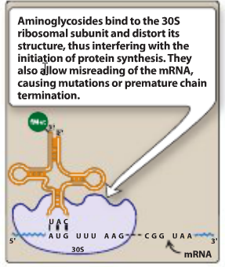

Slide 18
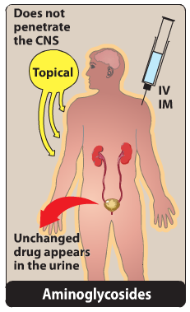
Pharmacokinetics of Aminoglycosides
Absorbance – given parenterally only
B. Fate after absorption
1. poor penetration into eukaryotic cells, CSF, eye
accumulation in perilymph and endolymph of the ear (toxicity)
C. Excretion – kidneys and liver (minor route)

Slide 19
Therapeutic Uses
– Usually given with another antibiotic like a beta-lactam for:
A. urinary tract infections
B. community acquired pneumonia
C. meningitis
D. peritoneal dialysis-associated peritonitis
E. bacterial endocarditis
F. sepsis

Slide 20
Toxicity/Contraindications
It is important to monitor plasma levels of gentamicin, tobramycin, and amikacin to avoid concentrations that cause dose-related toxicities
ototoxicity (common)
B. nephrotoxicity (common) - reversible
C. neuromuscular blockade (rare) – treatable with calcium salts
D. hypersensitivity to topically applied neomycin (uncommon)

Slide 21
III. MACROLIDES
Erythromycin is a natural product of Streptomyces erythreus;
clarithromycin and azithromycin are semi-synthetic derivatives

Slide 22
Effect of Macrolides
A. spectrum of coverage
effective against G+ rods and cocci
with few exceptions, ineffective against aerobic G- enteric bacteria
effective against atypical mycobacteria and some intracellular bacteria

Slide 23
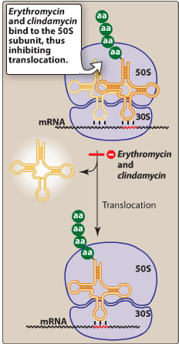
B. Mechanism(s) of action of Macrolides
in general, bacteristatic (can be bactericidal in high concentrations against susceptible bacteria)
binds ribosomes much like chloramphenicol

Slide 24
Pharmacokinetics of Macrolides
A. Absorption
1. administered orally
absorbed in upper small intestine
3. food delays absorption for erythromycin and azithromycin
B. Excretion
excreted by both the kidney and liver

Slide 25
Clarithromycin
Antimicrobial spectrum – slightly more effective against staph and strep than erythromycin
Absorption – can be given with food
Azithromycin
Antimicrobial spectrum
slightly less effective against G+
works better than other two macrolides against Haemophilus influenzae
works great against atypical mycobacteria

Slide 26
Therapeutic Uses of Macrolides
A. Mycoplasma infections
B. Chlamydia infections
C. staph and strep infections – safe alternative for patients sensitive to beta-lactams
D. gastrointestinal infections
1. Campylobacter gastroenteritis
2. Helicobacter pylori infections

Slide 27
Toxicity/Contraindications
Epigastric distress with large doses of erythromycin
Cholestatic hepatitis with estolate ester of erythromycin (rare)
Erythromycin and Clarithromycin inhibit CYP3A4 metabolism and thereby potentiate the effects of carbamazepine, corticosteroids, cyclosporine, digoxin, ergot alkaloids, theophylline, triazolam, valproate, and warfarin

Slide 28
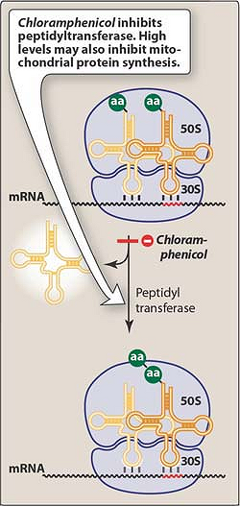
Chloramphenicol
produced by Streptomyces vnezuelae
Effect on Microbes
A. spectrum of coverage - broad
B. mechanism(s) of action
1. reversibly binds to ribosome
2. bacteristatic
---------
dosage should be adjusted in patients with hepatic failure, not necessarily renal failure

Slide 29
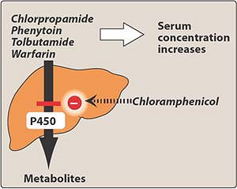

Slide 30
Therapeutic Uses (a “second choice” drug)
A. typhoid fever
B. bacterial meningitis
C. anaerobic infections
D. rickettsial disease

Slide 31
Toxicity/Contraindications-
A. hypersensitivity reactions
B. hematological toxicity
dose related toxicity that presents as anemia
aplastic anemia
C. gray baby syndrome
begins 2-9 days after treatment is initiated
within first 24 hr, babies start to vomit, refuse to suckle, have irregular and rapid respiration, abdominal distension, periods of cyanosis
can also occur in adults who overdose on chloramphenicol
death occurs in 40% of patients

Slide 32
Clindamycin
Effect on Microbes
A. spectrum of coverage
1. similar to macrolides
2. particularly effective against anaerobes (Bacteroides)
B. mechanism(s) of action – same as macrolides

Slide 33
Pharmacokinetics of Clindamycin
A. Absorbance
1. Well absorbed after oral administration
2. food does not interfere with absorption
3. can also be given parenterally or topically
B. Fate after absorption
wide distribution in tissues and bodily fluids, including bone
excluded from CSF, even during inflammation
readily crosses placenta
accumulates in PMN, alveolar macrophages, and in abscesses
C. Excretion
1. inactivated 90% by liver
2. excreted by kidneys

Slide 34
Therapeutic Uses
A. anaerobic infections except brain abscesses
B. staphylococcal infections
Toxicity/Contraindications
diarrhea (common)
pseudomembranous colitis due to overgrowth of toxin-producing Clostridium difficile (uncommon)
skin rash (uncommon to common)
SJS syndrome, granulocytopenia, thrombocytopenia, anaphylaxis (rare)

Slide 35
Streptogramins
Two streptogramins, one drug!
1. Streptogramin A is dalfopristin, streptogramin B is quinupristin
2. both are derivatives of the naturally occurring pristinamycin produced by Streptomyces pristinaespiralis
Synercid – a 30:70 mix of streptogramins A and B
spectrum of coverage: G+ cocci

Slide 36
Therapeutic Uses
A. treatment of vancomycin-resistant enterococci
B. treatment of methicillin-sensitive staph and strep skin infections
NOTE:
Inhibits CYP3A4 metabolism (same as macrolides)

Slide 37
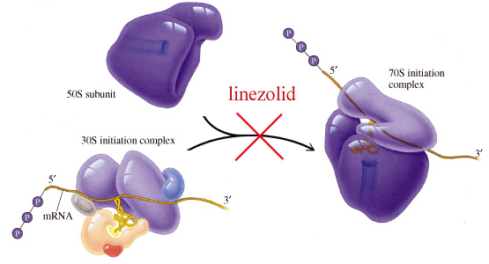
Linezolid
Chemistry:
synthetic agent (an oxazolidinone)
II. Effect on Microbes
A. spectrum of coverage
1. G+ only
2. not effective against anaerobes
mechanism(s) of action – similar to macrolides

Slide 38
Therapeutic Uses
A. treatment of vancomycin-resistant enterococci
B. treatment of methicillin-sensitive and resistant S. aureus
Toxicity / Contraindications
A. minor gastrointestinal complaints (common)
B. myelosuppression (uncommon)

