Slide 1
B-lactamase inhibitors products
Related to the past file 1
B-lactamase inhibitor + B-lactam drug,
the combination produces antibacterial activity with significant protection of b-lactam ring.

Slide 2
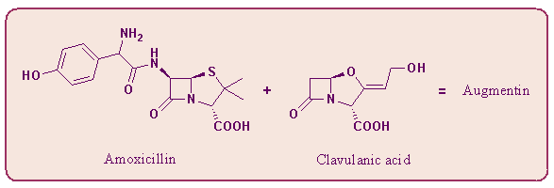

Related to the past file 2
Augmentin® or Augmentin BID®
Ticarcillin
Timentin® injection: Ticarcillin + Clavulanic Acid

Slide 3
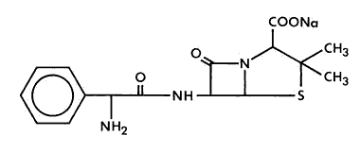
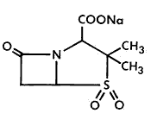
Unasyn® (injection)
Related to the past file 3
  Ampicillin Sodium + Sulbactam Sodium
Ampicillin
Sulbactam

Slide 4
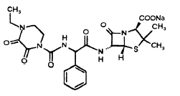
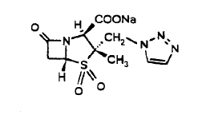
Tazocin®
Piperacillin + Tazobactam
Related to the past file 4
Piperacillin
Tazobactam
Piperacillin: extended spectrum beta-lactam antibiotic
Tazobactam: inhibits the action of bacterial β-lactamases

Slide 5
Cell Wall Synthesis Inhibitors
(2) Cephalosporins

Slide 6
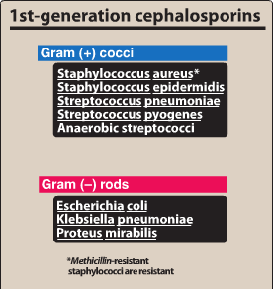
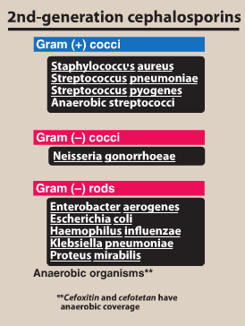
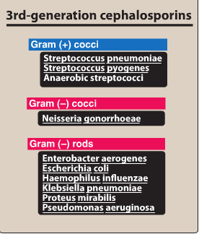
  Fourth Generation
  Cephalosporin: Cefepime
  Fifth Generation
  Cephalosporin: Cetobiprole

Slide 7
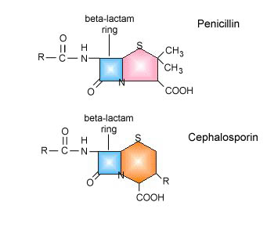
Cephalosporins
R groups determine spectrum of activity and pharmacological properties
Mechanism of action/resistance and class pharmacology essentially the same as penicillins

Slide 8
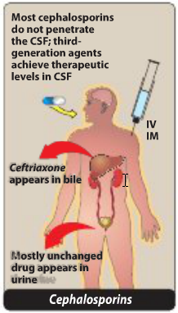

Slide 9
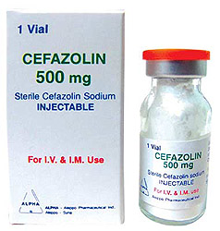
1st Generation Cephalosporins:
Cefazolin, cephalexin, cephadroxil
Excellent against susceptible staph and strep
Modest activity against G-
Cefazolin given parentally, others orally
Excreted by kidneys unmetabolized
Good for staph and strep skin and soft tissue infections

Slide 10
2nd Generation Cephalosporins
Cefaclor, cefuroxime, cefprozil, cefotetan, cefoxitine, cefamandole
Modest activity against G+, increased activity against G-, works against anaerobes
Absorption and excretion same as first gen.
Good for treating:
  respiratory tract infections
  intra-abdominal infections
  pelvic inflammatory disease
  diabetic foot ulcers

Slide 11
3rd Generation Cephalosporins
Cefotaxime, ceftriaxone, cefoperazone, cefpodoxime, cefixime
Broad spectrum killers
Drugs of choice for serious infections
No effect against Listeria and beta-lactamase producing pneumococci
Cefpodoxime and cefixime are given orally, others parentally
Most excreted by kidney
Therapeutic uses
  Bacterial meningitis (2 exceptions cefoperazone, cefixime)
  Life-threatening G- sepsis

Slide 12
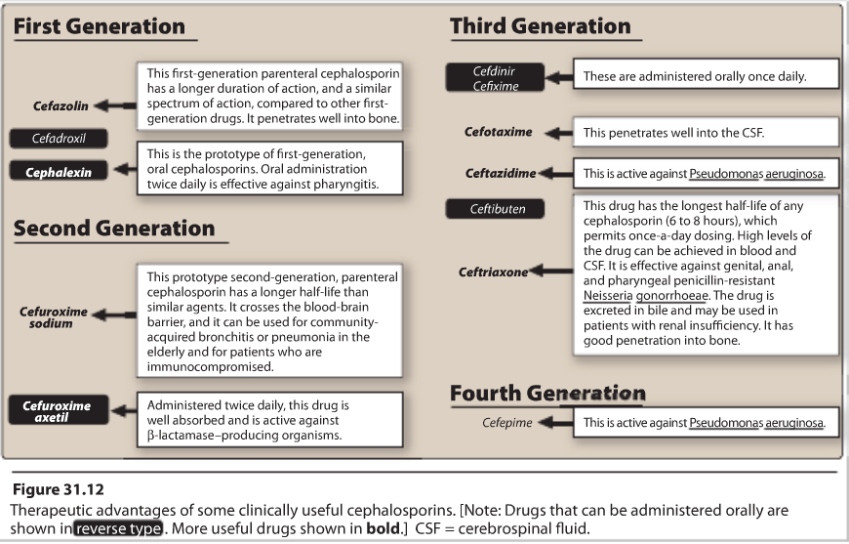

Slide 13
  Fourth Generation
  Cephalosporin: Cefepime
  Same antimicrobial spectrum as third generation but resists more beta-lactamases
  Given parentally, excellent penetration into CSF
  Good for nosocomial infections

Slide 14
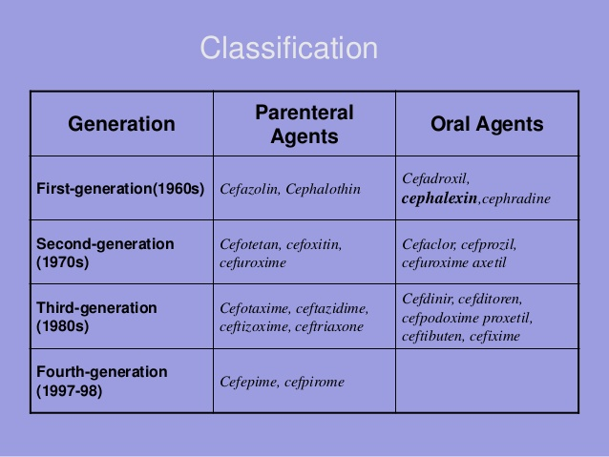

Slide 15
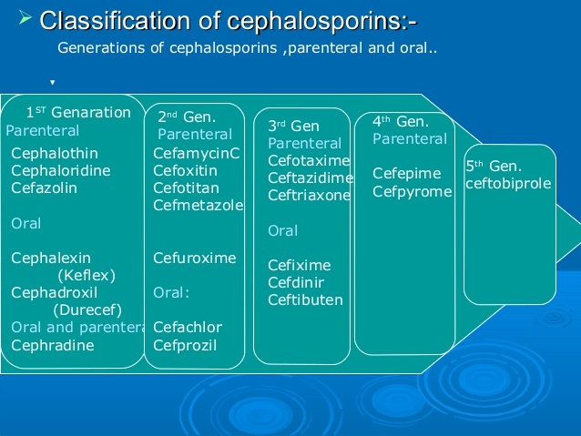

Slide 16
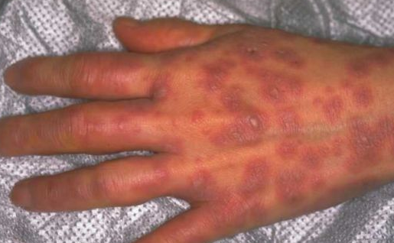
Toxicity/Contraindications of Cephalosporins
Hypersensitivity reactions (uncommon) essentially same as for penicillins
Cross-reaction between 2 classes

Slide 17
Other adverse effects:
  Pain at injection site
  Phlebitis after IV injection
  When given with aminoglycosides, may increase nephrotoxicity
  Drugs containing methylthiotetrazole (eg cefamandole, cefaperazone, cefotetan)may cause hypoprothrombinemia and disulfiram-like reaction.

Slide 18
4. Carbapenems
Imipenem, Meropenem, Ertapenem
Effect on microbes and pharmacology of carbapenems similar to penicillins
  Wider G+ activity, G-, and anaerobes
For pseudomonal infections: given with aminoglycosides
Parenteral administration
Drugs of choice for infections caused by Enterobacter.

Slide 19
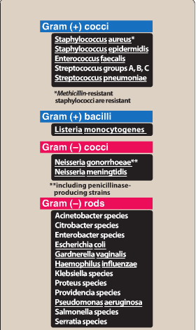
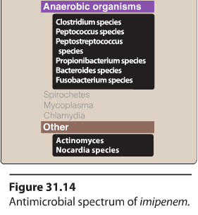

Slide 20
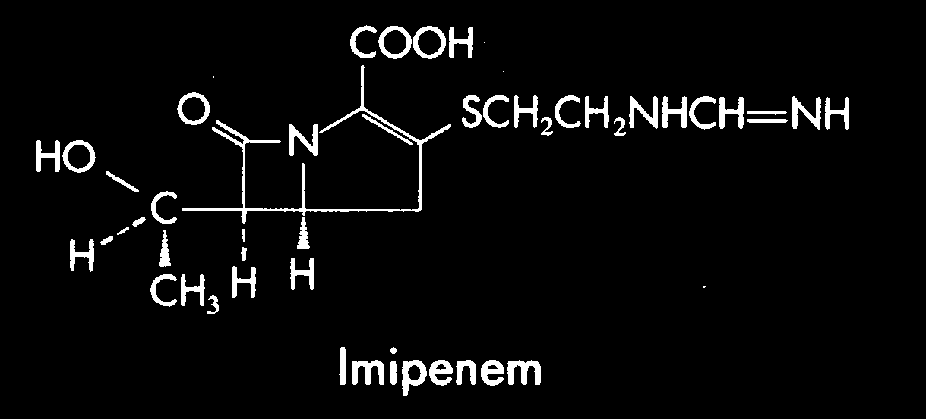
IMIPENEM-CILASTATIN (Primaxin®)
β−lactam ring

Slide 21
IMIPENEM-CILASTATIN
IMIPENEM is a carbapenem that binds to PBP-2 ⇒ cell lysis
CILASTATIN is a peptidase inhibitor that blocks renal degradation of Imipenem
Broad spectrum
Good coverage of hospital-acquired Gm(-) organisms including anaerobes
Allergic reactions

Slide 22
5. Monobactam: Aztreonam
Works only on G-, including Pseudomonas aeruginosa
Useful for treating G- infections that require a beta-lactam because it does not elicit hypersensitivity reactions

Slide 23
Toxicity/Contraindications of Carbapenems
Nausea and vomiting (common)
Hypersensitivity reactions (uncommon)
  Essentially the same as for penicillins, exception is the monobactam
  Cross-reactivity is possible, exception is the monobactam

Slide 24
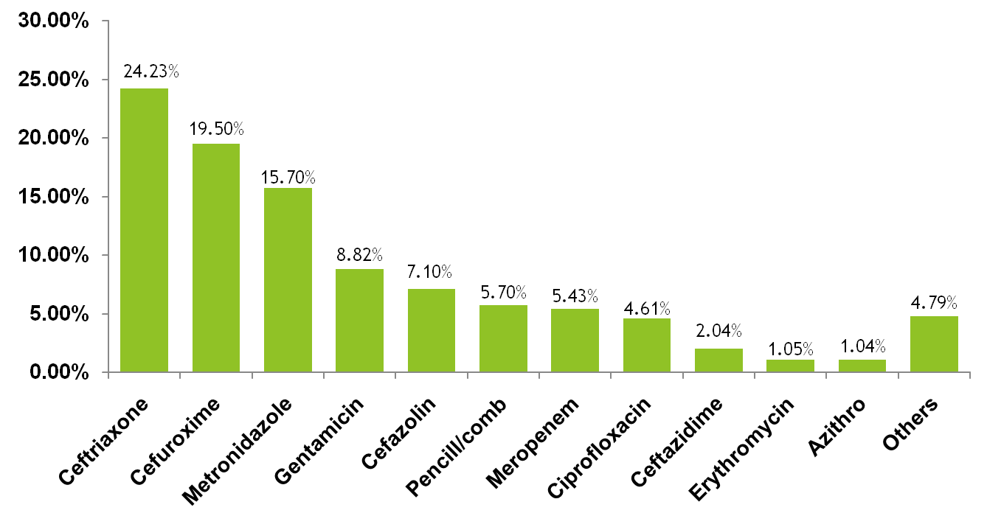
Palestinian Study 1: Percentage of total DDD of antimicrobial agents:
Notes:
Others resemble the antimicrobials agents with less than 1% of total DDD. ??? The reference line in the X-axis shows the DU90%.
DU90% ?

Slide 25
Palestinian Study 2: Antibiotics Use
The most commonly written or ordered antibiotic was:
  Amoxicillin 400 mg+ Clavulanic Acid 57 mg (Trade name Ogmin) in the suspension form with a percentage of 30.9%,
  Cefuroxime 250 mg tab (Trade name Zeinx) 30.1%.
  Table 1 summarizes the use of antibiotics.
Antibiotic used | percent
Amoxycillin 400mg+clavulanic acid 57mg (susp) | 30.9 %
Amoxicillin 500 (caps) | 2.1 %
Ceftriaxone 1g (vial) | 6.2 %
Ciprofloxacin 250mg (tab) | 7.6 %
Cephalexin 500mg (caps) | 11.8 %
Cefuroxime 250mg (tab) | 30.1 %
amoxicillin 500 + clavulanic acid (tablets) | 1.2 %

Slide 26
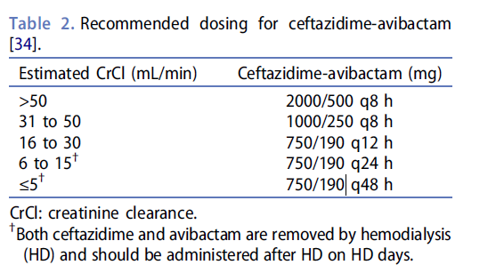
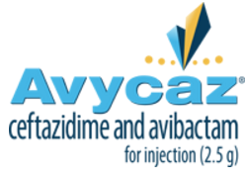
AVYCAZ® (ceftazidime and avibactam) for Injection
Ceftazidime-avibactam is a new β-lactam/β-lactamase inhibitor combination that recently received expedited FDA approval for use in adults:
  Complicated urinary tract infections (cUTI)
  cIAI (in combination with metronidazole)
Not suitable for empiric treatment, use if there are limited or no other available options.

Slide 27
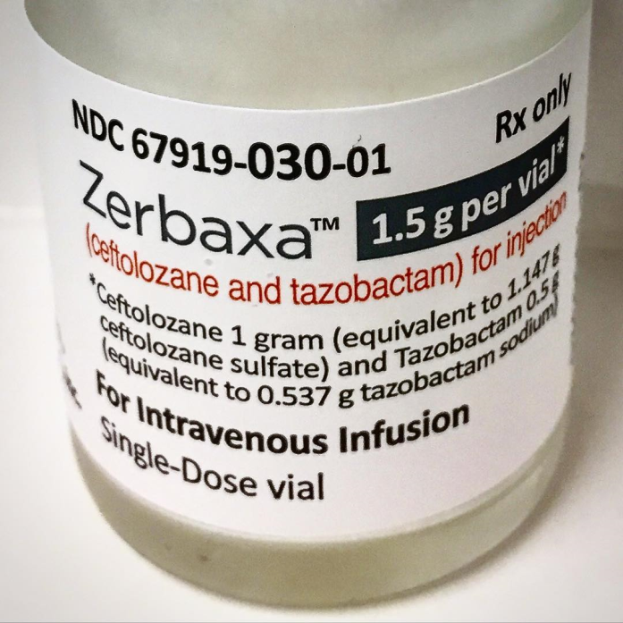
Ceftolozane and tazobactam
ZERBAXA® for injection
For patients with complicated urinary tract infections and, in combination with metronidazole
Complicated intra-abdominal infections

Slide 28
Cell Wall Synthesis Inhibitors
(Non-B-lactams)
Vancomycin
Daptomycin
Teicoplanin
Telvancin
Bacitracin

Slide 29
Vancomycin
Vancomycin is a tricyclic glycopeptide
Effective against multiple drug-resistant organisms, such as MRSA and enterococci.
Concerns about the emergence of vancomycin resistance.
Bacitracin is a mixture of polypeptides that also inhibits bacterial cell wall synthesis.
It is active against a wide variety of gram-positive organisms.
Its use is restricted to topical application because of its potential for nephrotoxicity with systemic use.

Slide 30
A. Mode of action of vancomycin
It inhibits:
  synthesis of bacterial cell wall phospholipids
  peptidoglycan polymerization by binding to the D-Ala-D-Ala side chain of the precursor pentapeptide.
This prevents the transglycosylation step in peptidoglycan polymerization, thus weakening the cell wall and damaging the underlying cell membrane.
Inhibits cell wall synthesis by inhibiting peptidoglycan synthetase

Slide 31
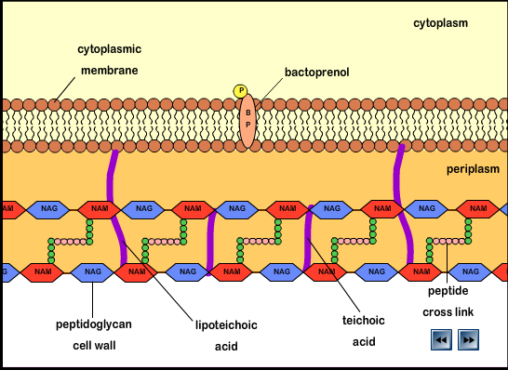

Slide 32
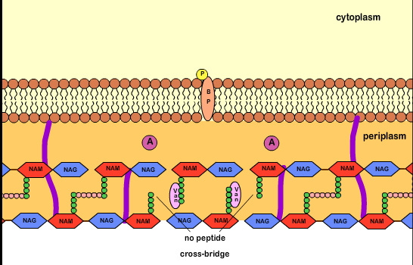

Slide 33
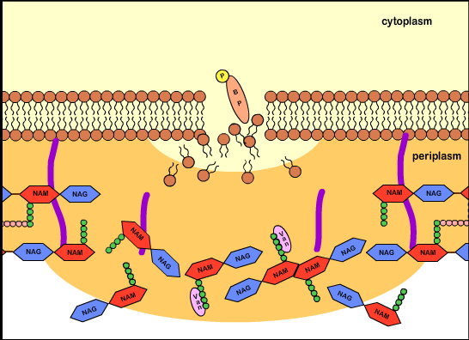

Slide 34
B: Antibacterial spectrum
Vancomycin is effective primarily against gram-positive organisms.
It has been lifesaving in the treatment of:
  MRSA
  methicillin-resistant Staphylococcus epidermidis (MRSE) infections
  enterococcal infections.

Slide 35
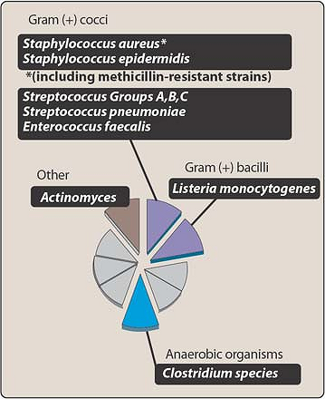

Slide 36
C: The use of vancomycin should be restricted to:
  the treatment of serious infections caused by β-lactam resistant, gram-positive microorganisms or
  for patients with gram-positive infections who have a serious allergy to the β-lactams.
Oral vancomycin:
  is limited to treatment for potentially life-threatening, antibiotic-associated colitis due to C. difficile or staphylcocci.

Slide 37
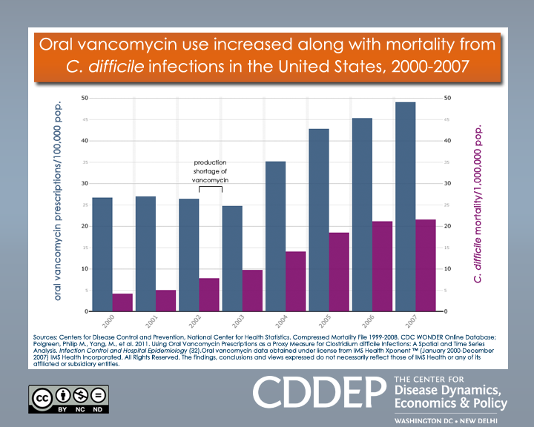

Slide 38
Treatment of vancomycin-resistant organisms:
  Daptomycin
  quinopristin/dalfopristin
  linezolid
Vancomycin acts synergistically with the aminoglycosides, and this combination can be used in the treatment of enterococcal endocarditis.

Slide 39
D. Pharmacokinetics of Vancomycin
    A. Absorbance
      usually given IV over an hour
      can be given orally for pseudomembranous colitis
    B. Fate after absorption
      1. 30% of drug bound to serum proteins
      appears in various bodily fluids, including CSF if inflammation is present
    C. Excretion - kidneys

Slide 40
E. Toxicity/Contraindications
A. Red-man syndrome (common)
  1. erythematous or urticarial reaction to rapid infusion
  2. mast cells are releasing histamine because of vancomycin’s toxicity
Ototoxicity and nephrotoxicity (uncommon to rare) due to excessively high concentrations

Slide 41
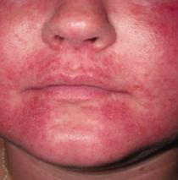
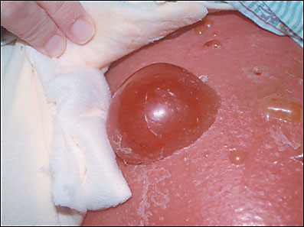
Red Man Syndrome
(Erythrodermatitis)

Slide 42
2. Others:
for treating infections caused by resistant gram-positive organisms, including:
  MRSA
  Vancomycin-resistant enterococci (VRE).
Daptomycin
Teicoplanin
Telvancin: A semi-synthetic lipoglycopeptide

