Slide 1

Pharmacodynamics
  Whats drugs do to the body”
  Mechanism of action
Notes:
In Greek
Pharmacon = Drug
Dynamics = Action/power

Slide 2
Action: How and where the effect of drug is produced
Effect: the type of response producing by drug

Slide 3
Drug action
Where
    Extracellular
    Cellular
    Intracellular
Types of responses
    Stimulation
    Inhibition/Depression/Replacement
    Irritation/Cytotoxic
Notes:
Drugs act by stimulating or depressing normal physiological functions. Stimulation increases the rate of activity while depression reduces the rate of activity
exchanging/replacing substances or accumulating them to form a reserve (ex.: glycogen storage
direct harmful chemical reaction which might result in damage or destruction of the cells, through induced toxic or lethal damage

Slide 4
Mechanism of drug action
Majority of drugs interact with target biomolecule (usually proteins)
  Enzymes
  Ion channels
  Neurotransmitter transport systems
  Nucleic acids
  Receptors

Slide 5
Receptor mediated action
Drugs produce their effects through interacting with some chemical compartment of living organism (receptor)
Receptors are macromolecules
Most are proteins
Present either on the cell surface, cytoplasm, or in the nucleus

Slide 6
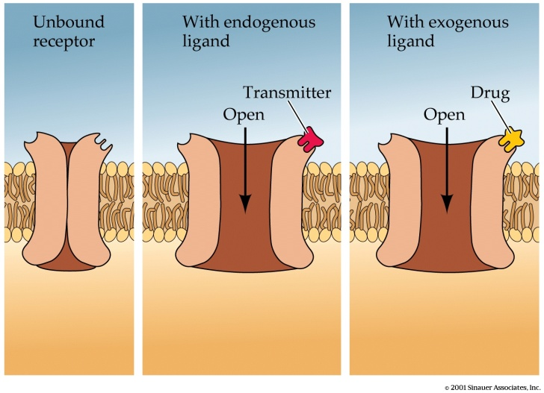
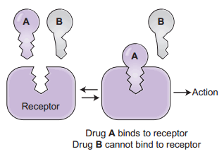
Receptors:
A macromolecular component of a cell with which a drug interacts to produce a response
Drug-Receptor Interactions
Drug/Receptor Binding
  Mimic actions of neurotransmitter at same site (agonist) (as endogenous molecules)
  Bind to nearby site and affect neurotransmitter binding (agonist/antagonist)
  Block actions of neurotransmitter at same site (antagonist)
Notes:
Receptors have specific sites ti bind the molecules (igands) non conalenty, this is called lock and key model

Slide 7
Types of Receptors:
  Membrane receptors
    Ion channels (Ligand-gated Ion Channels)
    G-protein coupled receptors
    Enzyme-linked receptors
  Intracellular receptor

Slide 8
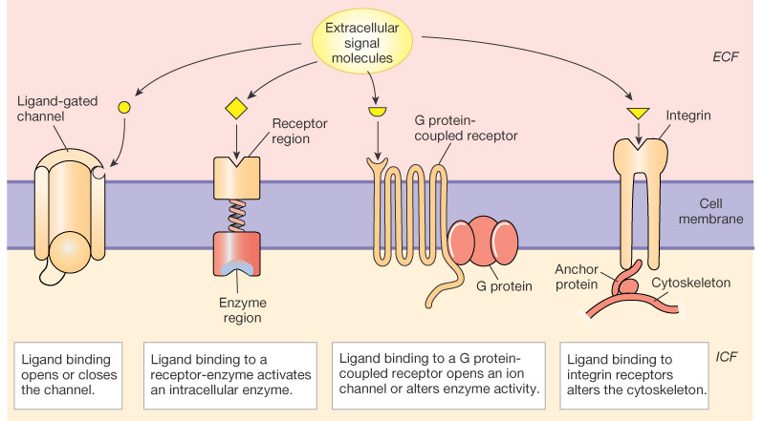
Membrane Receptor Classes
Figure 6-5: Four classes of membrane receptors
Notes:
1- The cell membrane does not allow hydrophilic molecules go through, so its need specific ligand gated channel for their moement ex; ion movement
2- ligand binding to the enzyme, enzyme activated inside the cell, GTP converted to cAMP
3- ligand bind to the receptor this change the shape of the receptor and then the shape of G-protein, this activates other enzymes and effector proteins
Intracellular protein: ligands can pass through cellular membrane and enter the cell into the nucleus, binding intracellular receptors, this can alter the transcription of the DNA withen a cell

Slide 9
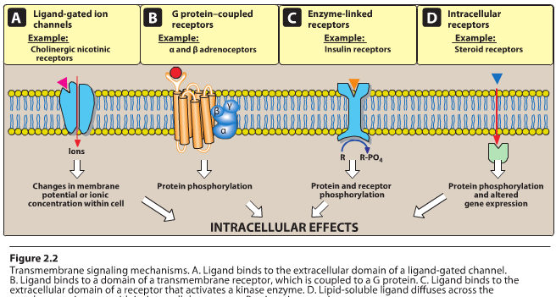
1. Ligand-gated Ion Channels
The activity is regulated by the binding of a ligand to the channel.
Response to these receptors is:
  Very rapid
  Lasts only a few milliseconds.
Mediate diverse function
  Neurotransmission
  Cardiac or skeletal muscle contraction
Notes:
The extracellular portion of ligand-gated ion channels usually contains the ligand binding sites. This site regulates the shape of the pore trough which ions can flow across the membrane

Slide 10
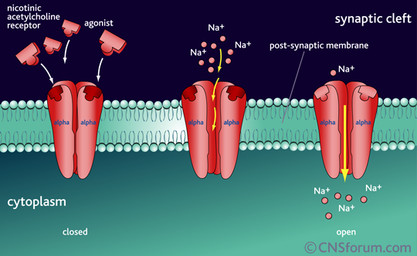
Ligand Gated Ion Channel
Notes:
For example, stimulation of the nicotinic receptor by acetylcholine results in sodium influx, generation of an action potential, and activation of contraction in skeletal muscle

Slide 11
2. G-protein coupled receptors
Seven transmembrane domains
Extracellular ligand-binding site
Intracellularly
  Linked to a G proteins (Gs, Gi, and others)
  Having three subunits, α subunit that binds GTP,β and γ
  Response usually lasts several seconds to minutes
Notes:
Guanosine triphosphate (GTP)
G proteins are so-called because they bind the guanine nucleotides GDP and GTP
The G_{s} alpha subunit (G_{αs}, G_{sα}, or G_{s} protein) is a heterotrimeric G protein subunit that activates the cAMP-dependent pathwayby activating adenylyl cyclase.

Slide 12
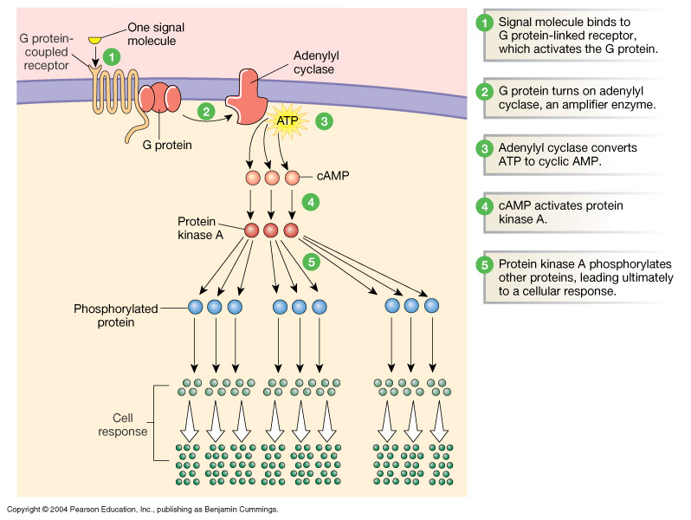
G-Protein-coupled Receptors
Figure 6-11: The G protein-coupled adenylyl cyclase-cAMP system
Notes:
Binding of an agonist with the receptor increases the GTP binding to α subunit, resulting in the dissociation of α-GTP
This will activate adenylyl cyclase ( an enzyme with key regulatory roles in essentially all cells, catalyse the conversion of adenosine triphosphate (ATP) to 3',5'-cyclic AMP (cAMP) andpyrophosphate)
Protein kinase: enzyme that modifies other proteins by chemically adding phosphate groups to them (phosphorylation). Phosphorylation usually results in a functional change of the target protein (substrate) by changing enzyme activity
Some examples of GPCRs include beta-adrenergic receptors, which bind epinephrine; prostaglandin E₂ receptors, which bind inflammatory substances called prostaglandins

Slide 13
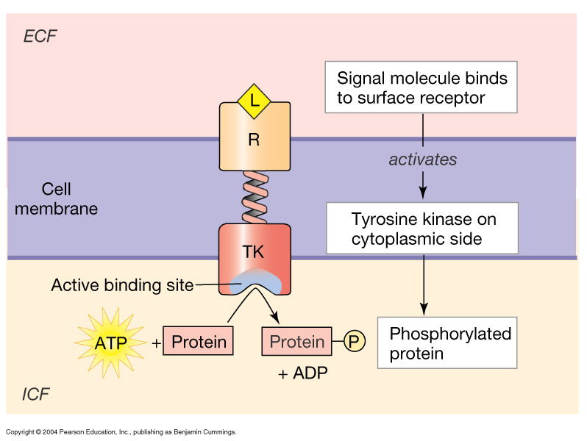
3. Enzyme-linked receptors:
This types of receptors form dimers or multisubunits
Activation increases cytoplasmic enzyme activity
  e.g., tyrosine kinase
The activated receptor phosphrylates tyrosine residues it self and then other specific proteins
Phosphorylation can modify the structure of the target protein
Figure 6-10: Tyrosine kinase, an example of a receptor-enzyme
Notes:
The activated receptor phosphrylates tyrosine residues it self and then other speciic proteins
Phosphorylation can modify the structure of the target protein
A tyrosine kinase is an enzyme that can transfer a phosphate group from ATP to a protein in a cell

Slide 14
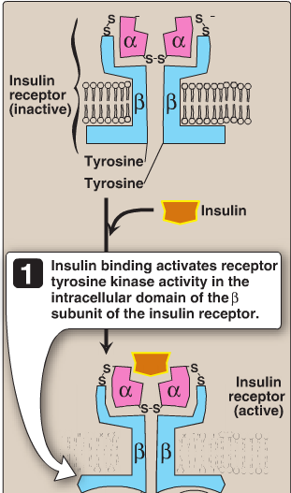
3. Enzyme-linked receptors:
Responses last on the order of minutes to hours.
Metabolism, growth, and differentiation are controlled by these types of receptors.
The most common enzyme-linked receptors:
  Epidermal growth factor
  platelet-derived growth factor
  Atrial natriuretic peptide
  Insulin
These receptors have a tyrosine kinase activity as part of their structure.
Notes:
Epidermal growth factor (EGF) is a growth factor that stimulates cell growth, proliferation, and differentiation by binding to its receptor EGF
Platelet-derived growth factor (PDGF) is one of the numerous growth factors, or proteins that regulate cell growth and division. In particular, it plays a significant role in blood vessel formation (angiogenesis), the growth of blood vessels from already-existing blood vessel tissue
Natriuretic peptide refers to a peptide which induces natriuresis (the discharge of sodium through urine), is a powerful vasodilator, and a protein (polypeptide) hormone secreted by heart muscle cells.^{[3][4][5]} It is involved in the homeostatic control of body water, sodium, potassium and fat (adipose tissue).
A tyrosine kinase is an enzyme that can transfer a phosphate group from ATP to a protein in a cell

Slide 15
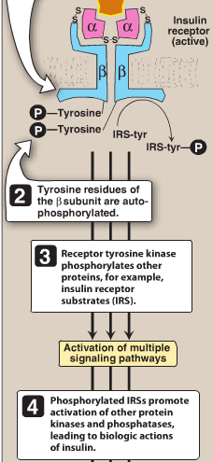
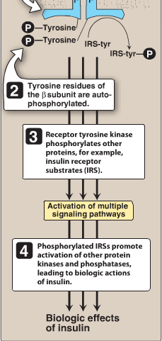

Slide 16
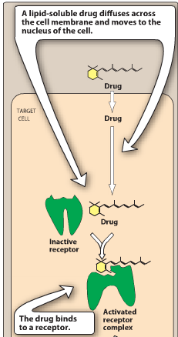
4. Intracellular receptors
The primary targets of these ligand-receptor complexes are transcription factors.
The activated ligand–receptor complex migrates or translocates to the nucleus, where it binds to specific DNA sequences, resulting in the regulation of gene expression.
The time course of activation and response is much longer.
Onset: 30 minutes or more
Duration of the response (hours to days)
Notes:
The receptor is completely intracellular
Ligand must diffuse into the cell, sot it must have sufficient lipid slubility
The target of DR complex is trnscription factors in the cell nucleus.

Slide 17
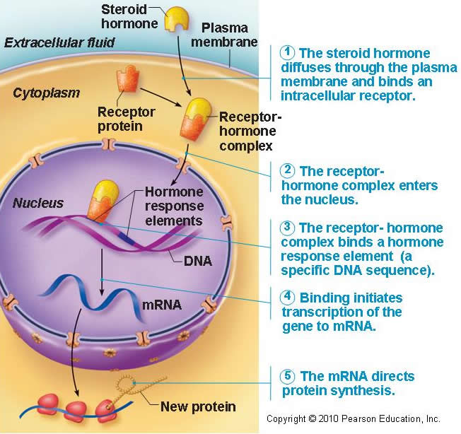
Notes:
Intracellular protein: ligands can pass through cellular membrane and enter the cell into the nucleus, binding intracellular receptors, this can alter the transcription of the DNA withen a cell

Slide 18
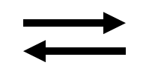
Drug-receptor binding
D + R DR Complex
Affinity
Affinity: measure of propensity of a drug to bind receptor; the attractiveness of drug and receptor
  Covalent bonds are stable and essentially irreversible
  Electrostatic bonds may be strong or weak, but are usually reversible
Efficacy: (or Intrinsic Activity) – ability of a bound drug to produces an effect
Potency: amount of drug necessary to produce an effect of a given magnitude
Effect
Notes:
Covalent bonds:
Drug and receptor share a pair of electrons
Very strong bond
Not very common in drug pharmacology
Electrostatic bonds:
Attraction due to charge differences
Vary in strength
Very strong (ionic bonds)
Very weak (van der Waals forces)
3. Most common in pharmacology

Slide 19
Dose response curves
Graded dose-response curve: (A response to a drug) such that as the dose of drug increases the intensity of the response increases. A graded dose-response relationship can be measured on a continuous scale
Quantal dose-response curve: can be constructed for drugs that elicit an all-or-none response (there either is or is not a response), eg, presence or absence of epileptic seizures
Notes:
Dose response relationships of the drug depends on the drug concentration at the receptor (depnd on the dose and pk)
Cont.scale as heart rate
Another important dose–response relationship is that between the dose of the drug and the proportion of a population that responds to it. These responses are known as quantal responses, because, for any individual, the effect either occurs or it does not. Graded responses can be transformed to quantal responses by designating a predetermined level of the graded response as the point at which a response occurs or not

Slide 20
Graded dose–response Relations
Potency: the amount of drug necessary to produce an effect of a given magnitude.
  Refers to the concentration (EC50) or dose (ED50) required to produce 50% of the drug's maximal effect
Efficacy (Magnitude of effect): maximal response
  references the response to the drug
  Therefore clinical effectiveness will depend not on potency but on maximal efficacy
Notes:
Effectiveness refers to the intervention’s ability to do more good than harm for the target population in a real world setting

Slide 21
Log Dose Scale
Transforms hyperbolic curve to a sigmoid (almost a straight line)
The relation between doses and responses will be linear
Better understanding and interpretation can be drawn from
By this way we can choose optimized dose of substance (i.e. EC50, EC80) for mechanistic studies
Easier to analyze mathematically

Slide 22
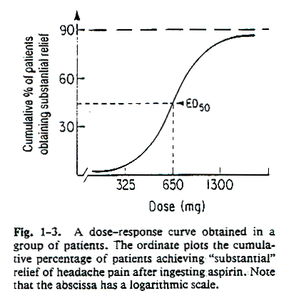
Notes:
Maximal efficacy of a drug assumes that all receptors are occupied by the drug, and no increase in response will be observed if more drugs are added.

Slide 23
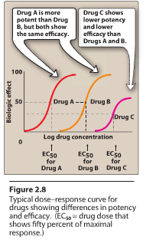
Notes:
A drug with greater efficacy is more therapeutically beneficial than one that is more potent

Slide 24


Concepts to remember!
  Threshold: Dose that produces a just-noticeable effect.
  ED₅₀: Dose that produces a 50% of maximal response.
  EC50: Concentration of the drug that produce 50%of maximal response
  Ceiling: Lowest dose that produces a maximal effect.

Slide 25
Dose-response curve
Response
Log Dose

Slide 26
Classification of a drug based on drug-receptor interactions

Slide 27
Agonist Drugs
Two types:
  Full agonist
    Drug binds to a receptor and produces a maximal biologic response (efficacy) that mimics the response to the endogenous ligand
  Partial agonist
    Drug, no matter how high the dose, cannot produce a full response
    Efficacy (intrinsic activity) greater than zero but less than full agonist
    Affinity may be greater than, less than, or equivalent to that of a full agonist
    Have both agonist and antagonist properties (may act as an antagonist of a full agonist)
Notes:
phenylephrine is an agonist at α1-adrenoceptors, because it produces effects that resemble the action of the endogenous ligand, norepinephrine
In general, a full agonist has a strong affinity for its receptor and good efficacy

Slide 28
Agonist Dose Response Curves
Full agonist
Partial agonist
Response
Dose

Slide 29
PARTIAL AGONISTS - EFFICACY
Even though drugs may occupy the same # of receptors, the magnitude of their effects may differ.
Full Agonist
1.0
Partial agonist
0.8
0.6
Partial agonist
% Maximal Effect
0.4
0.2
0.0
0.01
0.10
1.00
10.00
100.00
1000.00
[D]
(concentration units)

Slide 30
Antagonist Drug
Drug that binds to receptors but cannot initiate a cellular response, but prevent agonists from producing a response
. Antagonists maintain the active-inactive equilibrium
Two types:
  Competitive: Antagonist binds to same site as agonist in a reversible manner.
  Noncompetitive: Antagonist binds to the same site as agonist irreversibly.
Notes:
antagonist drug have affinity, but no efficacy

Slide 31
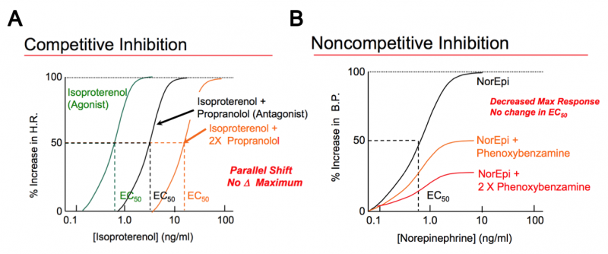

Slide 32
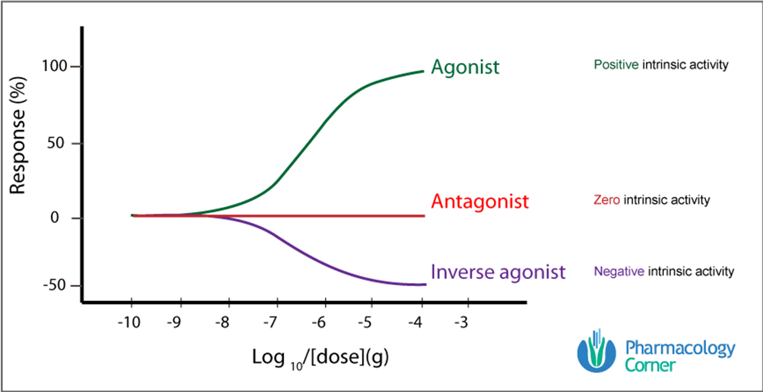
Inverse Agonist
Drug that binds to a receptor to produce an effect opposite that of an agonist.
Stabilizes receptors in the inactive state.
Notes:
Physiologic Antagonists: Two drugs have opposite effects through differing mechanisms
Norepinephrine → Vasoconstriction → ↑ BP.
Histamine → Relax vascular smooth muscle→ ↓BP
Allosteric: Antagonist and agonist bind to different site on same receptor

Slide 33
Effectiveness, toxicity, lethality
ED50 - Median Effective Dose 50 ; the dose at which 50% of the population or sample manifests a given effect.
TD50 - Median Toxic Dose 50 - dose at which 50% of the population manifests a given toxic effect
LD50 - Median Toxic Dose 50 - dose which kills 50% of the subjects
Therapeutic Index = TD50 or LD50/ ED50

Slide 34
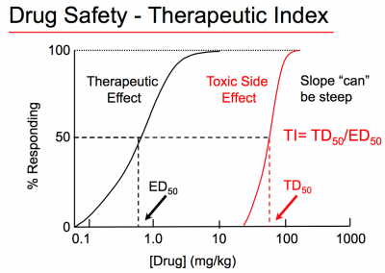

Slide 35
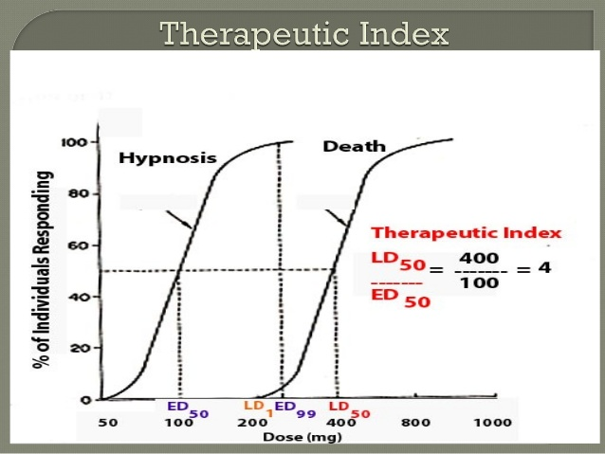

Slide 36
Unusual Responses:
Definitions:
Idiosyncratic response: unusual response
Hyporeactive: less than normal response
Hyperreactive: more than normal response
Hypersensitivity: allergic or other immunological reaction
Tolerance: decreased response with continued administration
Tachyphylaxis: rapidly developing tolerance

Slide 37
Pharmacodynamics

Slide 38
Pharmacodynamics
Drugs A and B are more potent than drugs C and D because of the relative positions of their dose-response curves along the dose axis (log concentration)
Drugs B, C and D are equally efficacious (similar maximal efficacies), more effective than the more potent drug A.

