Slide 1
Pharmacokinetics
A D M E
Afnan Atallah, Ph.D.
Al-Quds University

Slide 3
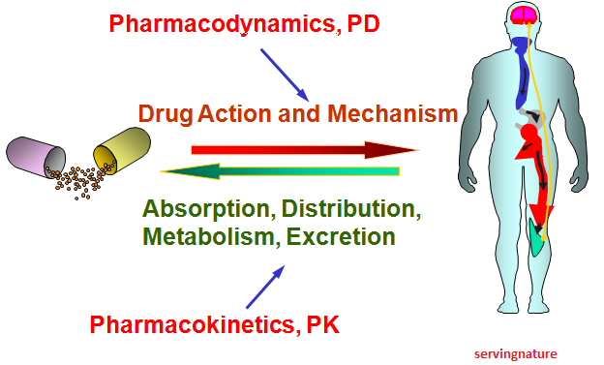
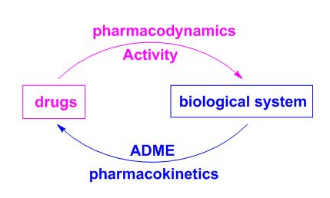

Slide 4
I. ABSORPTION OF DRUGS
Absorption: is the transfer of a drug from its site of administration to the bloodstream via one of several mechanisms. (except for drugs that are applied directly to the target tissue)
The rate and extent of absorption depend on:
the environment where the drug is absorbed
The chemical characteristics of the drug
Route of administration (bioavailability).
Notes:
All Routes of administration except IV injection may result in partial absorbtion and lower bioavailability
Drugs administrationorally has several barriers to absorption, so absorption of orally administered drugs is usually delayed and incomplete.

Slide 5
Absorption: Rate & Extent
Rate: how rapidly does the drug get from its site of administration to the general circulation ?
Extent: How much of the administered dose enters the general circulation ? ( % bioavailability = F)

Slide 6
Rate versus extent of absorption

Slide 7
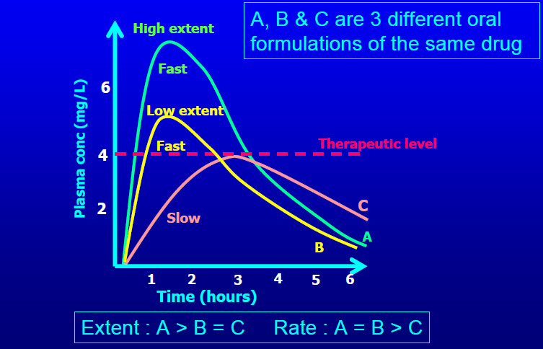
Rate versus extent of absorption

Slide 8
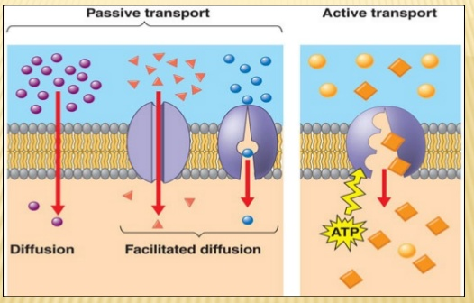
Mechanisms of absorption of drugs from the GI tract

Slide 9
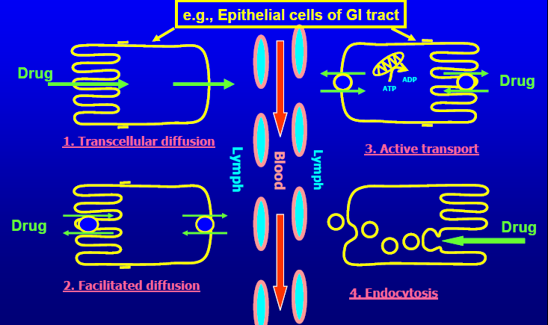
Mechanisms of absorption of drugs from the GI tract

Slide 10
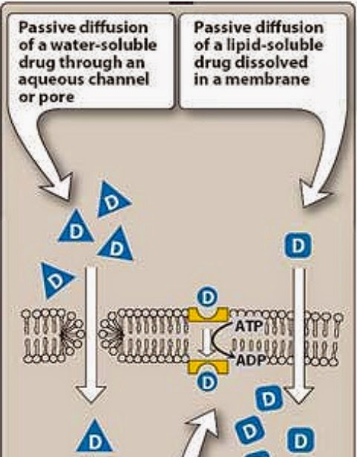
passive diffusion: Movement of a solute through a biological barrier from the phase of higher concentration to phase of lower concentration (No need of energy and carrier)
e.g. highly lipid soluble drugs
Notes:
1- movement of drug is concentration gradient across the membrane
not saturable
low structural selectivity

Slide 11
Facilitated diffusion: It means the passage of drug across the biological membrane along the concentration gradient by the protein carrier mediated system also called as carrier mediated diffusion
Active transport: The process by which drugs pass across the biological membrane most often against their concentration gradient with the help of carriers along with the expenditure of energy
Endocytosis: It is the process by which the large molecules are engulfed by the cell membrane and releases them intracellularly
Notes:
2- e.g. tetracycline, pyrimidine/ can be saturated or inhibited by compounds compet on the same carrier
3- e.g. alpha methyl dopa, levodopa, 5-fluoro-uracil, 5 bromouracil
Competitive inhibition is possible
can be saturated
selective
Used by endogenous substances ordinarily
Example - weak acid carriers in the renal tubule
Some Drugs: e.g. 5-fluorouracil
4- e.g. protein, toxins (botulinum, diphtheria)

Slide 12
Factors influencing absorption
Effect of pH on drug absorption
Blood flow to the absorption site
Total surface area available for absorption
Contact time at the absorption surface
Expression of P-glycoprotein
Notes:
1-
most of drugs either weak acids or weak bases
2- the intestines recieve much more blood than stomach, so absorption through intestine is favored
5- p-gp transmembane transporter protein, involved in transportation of drugs from tissues to blood, pump the drug out of the cells
Rule of thumb
Charged form of an acid or basic drug is more water soluble
More of an acidic drug will be in the water soluble state at alkaline pH’s
More of basic drug will be water soluble state at acidic pH’s.
Put an acidic or basic drug in the OPPOSITE environment to achieve water solubility (and visa versa).

Slide 13
Bioavailability
Bioavailability is the fraction of administered drug that reaches the systemic circulation.
Or, it is the rate and extent to which an administrated drug reaches the systemic circulation
For example
if 100 mg of a drug are administered orally
70 mg of this drug are absorbed unchanged
the bioavailability is 0.7, or 70 percent.

Slide 14
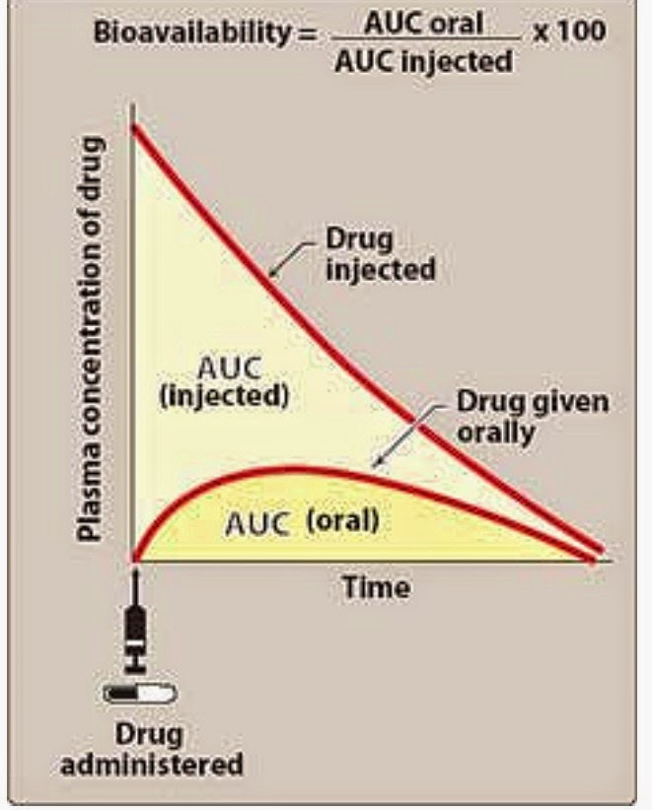
Determination of bioavailability
Bioavailability is determined by comparing plasma levels of a drug after a particular route of administration (for example, oral administration) with plasma drug levels achieved by IV injection
Determining bioavailability is important for calculating drug dosages for non-intravenous routes of administration

Slide 16
Factors that influence bioavailability
1- First-pass hepatic metabolism If the drug is rapidly metabolized by the liver, the amount of unchanged drug that gains access to the systemic circulation is decreased
2- Solubility of the drug:
Very hydrophilic drugs are poorly absorbed because of their inability to cross the lipid-rich cell membranes
Extremely lipophilic drugs are also poorly absorbed, because they are totally insoluble in aqueous body fluids and, and cannot gain access to the surface of cells
drug to be readily absorbed, it must be largely lipophilic, and have some solubility in aqueous solutions. This is one reason why many drugs are weak acids or weak bases
Notes:
2-
3- Chemical instability:
Some drugs, such as penicillin G, are unstable in the pH of the gastric contents. Others, such as insulin, are destroyed in the GI tract by degradative enzymes.
4- Drug absorption may be altered by factors unrelated to the chemistry of the drug. For example, particle size, salt form, crystal polymorphism, enteric coatings and the presence of excipients (such as binders and dispersing agents) can influence the ease of dissolution and, therefore, alter the rate of absorption.

Slide 17
Factors that influence bioavailability
3. Chemical instability
Some drugs, such as penicillin G, are unstable in the pH of the gastric contents
Others, such as insulin, are destroyed in the GI tract by degradative enzymes
4. Nature of the drug formulation
Drug absorption may be altered by factors unrelated to the chemistry of the drug
For example, particle size, salt form, enteric coatings and the presence of excipients can influence the ease of dissolution and, therefore, alter the rate of absorption.
Notes:
2- Very hydrophilic drugs are poorly absorbed because of their inability to cross the lipid-rich cell membranes. Paradoxically, drugs that are extremely lipophilic are also poorly absorbed, because they are totally insoluble in aqueous body fluids and, therefore, cannot gain access to the surface.
of cells.
3- 3. Chemical instability:
Some drugs, such as penicillin G, are unstable in the pH of the gastric contents. Others, such as insulin, are destroyed in the GI tract by degradative enzymes
4- Drug absorption may be altered by factors unrelated to the chemistry of the drug. For example, particle size, salt form, crystal polymorphism, enteric coatings and the presence of excipients (such as binders and dispersing agents) can influence the ease of dissolution and, therefore, alter the rate of absorption.

Slide 18
Factors influencing the oral bioavailability of drugs :
Decomposition in acidic gastric juices
Decomposition by hydrolytic gut enzymes (eg, proteases, lipases)
Degradation by gut microorganisms
Food in the gut may alter absorption rate and amount (eg. interact or form a complex)
Metabolism by gut wall enzymes
Metabolism by liver enzymes prior to reaching the systemic circulation (first-pass metabolism)

Slide 19
Bioequivalence
Two related drug preparations are bioequivalent if:
They show comparable bioavailability
Similar times to achieve peak blood concentrations.
Therapeutic equivalence
Two similar drug products are therapeutically equal if they are pharmaceutically equivalent with similar clinical and safety profiles
Notes:
pharmaceutically equivalent : having the same dosage form, contain the same active ingredient, use the same route of administration
Clinical effectiveness often depends on both the maximum serum drug concentrations and on the time required (after administration) to reach peak concentration. Therefore, two drugs that are bioequivalent may not be therapeutically equivalent.]

Slide 20
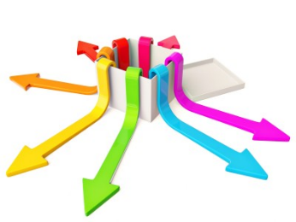
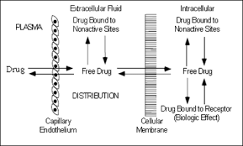
II. DRUG DISTRIBUTION
Distribution: is the process by which a drug reversibly leaves the blood-stream and enters the interstitium (extracellular fluid) and then the cells of the tissues.

Slide 21
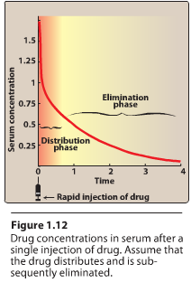
Notes:
For drugs administered IV, the initial phase represents the ditibution phase not the absorption phase; during which drugs leaves the circulation and enters th tisues

Slide 22
Factors affecting drug distribution
The delivery of a drug from the plasma to the interstitium primarily depends on:
Cardiac output and regional blood flow
Capillary permeability
The tissue volume
The degree of binding of the drug to plasma and tissue proteins
lipophilicity of the drug
Notes:
1- Brain, liver and kidney (vessel-rich organs) have greater blood flow than the skeletal muscles,
adipose tissue, skin and viscera have lower rates of blood flow

Slide 23
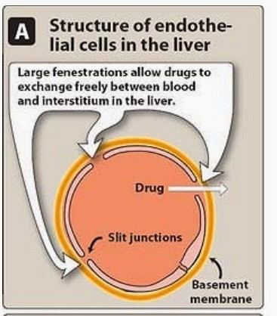
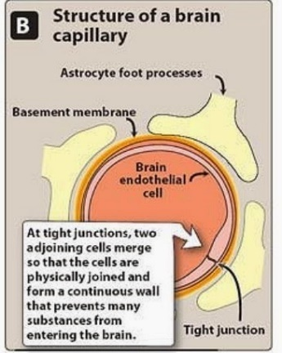
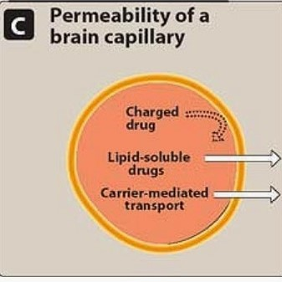
Factors affecting Capillary permeability
Capillary structure
Drug structure
Hydrophobic drugs are readily move across most biologic membranes.
hydrophilic drugs are not readily penetrate cell membranes, and must go through the slit junctions.
Notes:
Capillary structure varies widely in terms of the fraction of the basement membrane that is exposed by slit junctions between endothelial cells.
In the liver and spleen, where a large part of the basement membrane is exposed due to large, discontinuous capillaries through which large plasma proteins can pass. In the brain, the capillary structure is continuous, and there are no slit junctions.

Slide 24
Binding of drugs to plasma proteins:
Binding to plasma proteins: Reversible binding to plasma proteins (as albumin) sequesters drugs in a nondiffusible form and slows their transfer out of the vascular compartment
Binding to tissue proteins: many drugs accumulate in tissues (binding to lipids, proteins, or nucleic acids), leading to higher concentration in tissues than in the extracellular fluid and blood
Prolong drug action
Local drug toxicity

Slide 25
Volume of distribution:
The volume of distribution (V_{d}), = apparent volume of distribution is defined as
The distribution of a medication between plasma and the rest of the body
Or,
Apparent or hypothetical volume of fluid into which a drug is homogeneously distributed in the body
V_{d} is a property of the drug and is determined by the drug’s manufacturer

Slide 28
Apparent volume of distribution:
No exclusive distribution to water compartments.
Majority of drugs distribute into several compartments, often avidly binding cellular components, such as, lipids, proteins, nucleic acids
The volume into which drugs distribute is called the apparent volume of distribution (V_{d})
If V_{d} is big the drug is more diluted than it should be (in the blood plasma), meaning more of it is distributed in tissue (i.e. not in plasma).

Slide 29
Determination of V_{d}
V_{d} is useful to compare the distribution of a drug with the volumes of the water compartments in the body.
V_{d} is useful for calculating loading dose of a drug

Slide 30
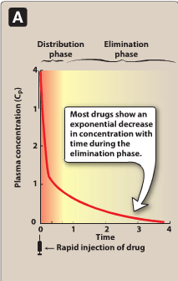
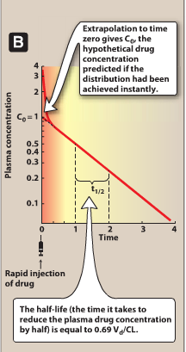
log

Slide 31
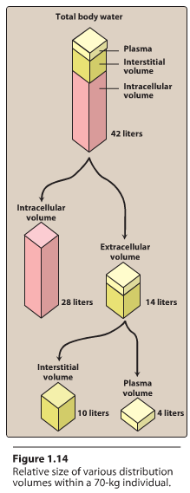
Distribution into the water compartments in the body:
Once a drug enters the body, it has the potential to:
distribute into any one of the three functionally distinct compartments of the body water or
become sequestered in a cellular site.

Slide 32
Effect of V_{d} on drug half-life:
V_{d} has an important influence on the half-life of a drug
As drug elimination depends on the amount of drug delivered to the organs of metabolism per unit of time
Larg V_{d} for a drug, most of the drug is in the extraplasmic space and is unavailable to the excretory organs.
Any factor that increases V_{d} can lead to:
An increase in the half-life
Extend the duration of action.
Delivery of drug to the organs of elimination depends on:
Blood flow
The fraction of the drug in the plasma.

Slide 33
III. DRUG CLEARANCE THROUGH METABOLISM

Slide 34
III. DRUG CLEARANCE THROUGH METABOLISM
The process of elimination begins as soon as the drug enters the body.
Three major routes of elimination:
1) hepatic metabolism
2) elimination in bile
3) elimination in urine.

Slide 35
Elimination causes the plasma concentration of a drug to decrease exponentially.
A constant fraction of the drug is eliminated in a unit of time.

Slide 36
Metabolism leads to products with increased polarity, which will allow the drug to be eliminated.
Clearance (CL) estimates the amount of drug cleared from the body per unit of time
Elimination could be through
first-order kinetics: most drugs
zero-order or non-linear kinetics: e.g. aspirin in high doses
.

Slide 37
1st order elimination vs. zero order elimination
Drug half-life is often used as a measurement of drug CL, as , V_{d} is a constant for many drugs.
Notes:
1st order elimination means that a constant fraction of drug is metabolized per unit time ( with each half life the conc decreases by 50%) = linear kinetics
Zero ordder kietics: doses are very large, the enzymes is saturated by a high free drug conc, and the rate of metabolism remains constant over time
This is caled zero-order kinetics are also called “non-linear kinetics”. Constant amount of drug is metabolized per unit of time, and undependent on the drug conc

Slide 38
log

Slide 39
Reactions of drug metabolism
Lipophilic drugs are not efficiently eliminated by the kidney
Lipophilic drugs must first be metabolized into more polar (hydrophilic) substances in the liver
Two general sets of reactions
Phase I
Phase II
(lipophilic)
(hydrophilic)
Notes:
Lipophilic drugs are reabsorbed in the distal convoluted tubules

Slide 40
Phase I:
Phase I reactions convert lipophilic molecules into more polar molecules by:
introducing or unmasking a polar functional group such as –OH or –NH2.
Pharmacologic activity after phase I metabolism may:
Increase
Decrease
Unchanged

Slide 42
Phase I reactions utilizing the P450 system:
Are catalyzed by the cytochrome P450 system (microsomal mixed-function oxidases)
The most common reaction catalyzed by cytochromes P450 is a monooxygenase reaction
e.g., insertion of one atom of oxygen into an organic substrate (RH) while the other oxygen atom is reduced to water:
Notes:
Hepatic microsomal CYP450-dependent electron transfer chain

Slide 43
Cytochrome P450 (CYP)
The P450 system is important for the:
metabolism of endogenous compounds (such as steroids, lipids, etc.)
the biotransformation of exogenous substances (xenobiotics)
Cytochrome P450 (CYP450) is :
Superfamily of heme-containinig isoenzymes
Located in most cells (primarily in the liver and GI tract)
P: pigment as these enzymes are red because of their heme group
450: wavelength of the absorption maximum of the enzyme when it is in the reduced state and complexed with CO.

Slide 44
1) Nomenclature:
The enzymes themselves, are designated with the abbreviation CYP
Followed by a number indicating the family (3)
A capital letter indicating the subfamily (A)
Another numeral for the individual gene or specific enzymes (4)
Example: CYP3A4.

Slide 45
2) Specificity:
Many different P450 isoforms.
They can modify a large number of structurally diverse substrates.
One drug may be a substrate for more than one isozyme.
Four isozymes are responsible for the vast majority of P450-catalyzed reactions.
CYP3A4/5
CYP2D6
CYP2C8/9
CYP1A2
Considerable amounts of CYP3A4 are found in intestinal mucosa ( responsible for first-pass metabolism)
Notes:
Many different genes that encode multiple enzymes there are many different P450

Slide 46
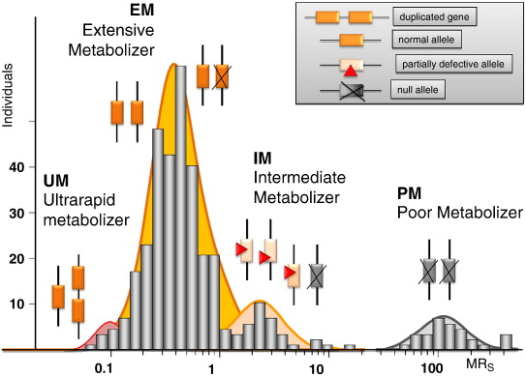
3) Genetic variability:
P450 enzymes exhibit considerable genetic variability among individuals and racial groups.
Variations in P450 activity may alter a drug’s efficacy and the risk of adverse events.

Slide 47
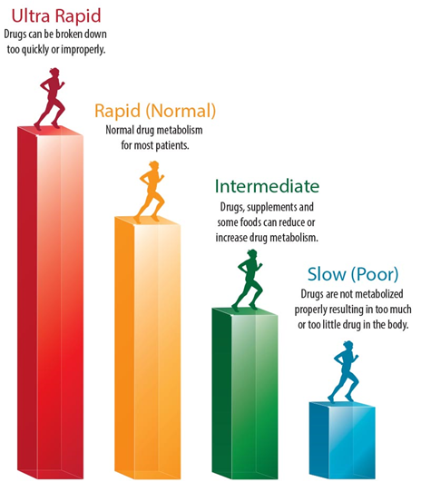

Slide 48
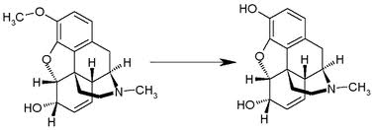
Example 1:
CYP2D6 exhibits genetic polymorphism.
Patients lacking CYP2D6 can not benefit from codeine analgesic effect
Codeine is activated by O-demethylation by CYP2D6 enzyme
This polymorphism is in part racially determined:
5 to 10 percent in European Caucasians
2 percent of Southeast Asians
Demethylation
Codeine
Morphine
Notes:
4 CYP2D6 mutations result in very low metabolizing capacities.

Slide 49
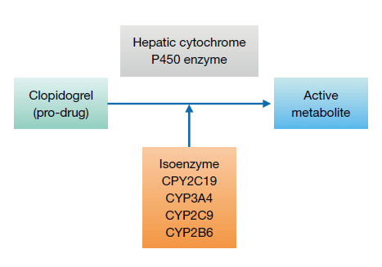
Example 2:
CYP2C subfamily of isozymes.
Clopidogrel is CYP2C19 substrate
Poor CYP2C19 metabolizers have a higher incidence of cardiovascular events (for example, stroke or myocardial infarction) when taking clopidogrel.
Notes:
Clopidogrel: antiplatelet

Slide 50
4) Inducers:
Enzyme synthesis initiated within 24 h of exposure, increasing over 3 –5 days
Effect decreases over 1 –3 weeks after inducing agent is discontinued
Environmental Factors and xenobiotics:
Cigarette smoking, high protein diet, ethanol, exposure to insecticides (DDT, Lindane) & polychlorinated biphenyl (PCBs)
Certain drugs:
Barbiturates, phenytoin, carbamazepine, rifampicin& dexamethasone
Notes:
Xenobiotics: chemicals not normally produced or expected to be present in the body, for example, drugs or enviromental pollutants

Slide 51
Consequence of increasing drug metabolism
Decrease plasma drug concentrations
Decrease drug activity if the metabolite is inactive
Increase drug activity if the metabolite is active
Decrease therapeutic drug effect

Slide 52
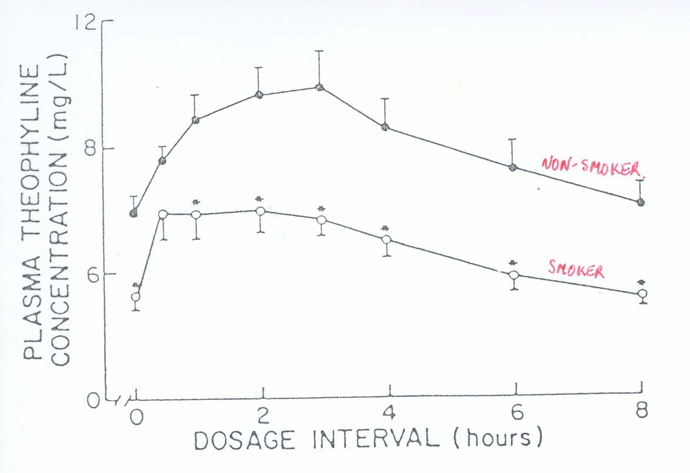
The effect of smoking on theophyline metabolism

Slide 53
5) Inhibitors:
Inhibition of CYP isoenzyme activity is an important source of drug interactions
Forms of inhibition:
Through competition for the same isozyme.
Inhibiting reactions for which they are not substrates (e.g., ketoconazole)

Slide 54
Important CYP inhibitors are:
Drugs: Erythromycin, Ketoconazole, Ritonavir, Cimetidine
Natural substances may also inhibit drug metabolism.
grapefruit and its juice inhibits CYP3A4
Examples on drugs that are substrate s for this enzyme are:
Nifedipine (CCBs)
Clarithromycin (Macrolide antibiotic)
Simvastatin (Lipid lowering agent)

Slide 55
Example: Warfarin biotransformation may be inhibited by omeprazole
Omeprazole is a potent inhibitor of three of the CYP isozymes responsible for warfarin metabolism
If the two drugs are taken together, plasma concentrations of warfarin increase, which leads to greater inhibition of coagulation and risk of hemorrhage and other serious bleeding reactions.

Slide 56
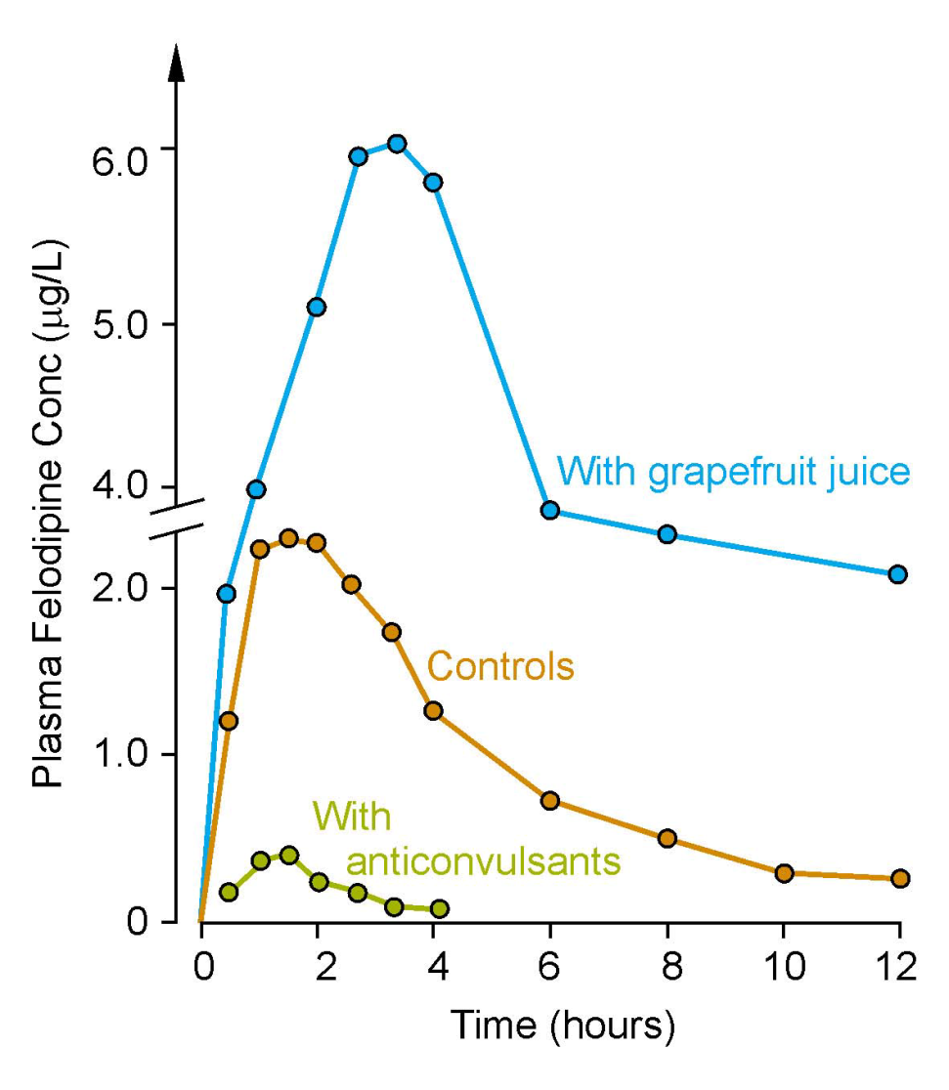
Bioavailability of felodipine after an oral after dose in patients receiving anticonvulsants (carbamazepine), and in healthy volunteers taken with a glass of water (controls) or grapefruit juice
Inhibition
Induction
Notes:
Felodipine: CCB, treat hypertension

Slide 57
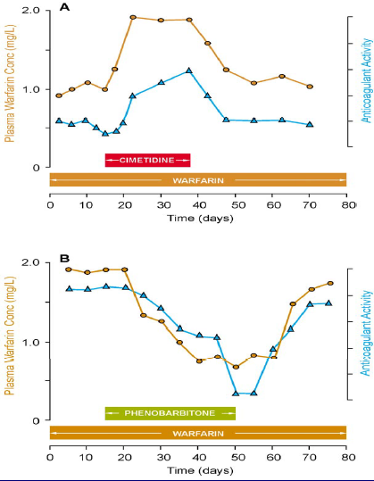
Inhibition/induction of warfarin metabolism, examples …
The effect of co-administration of the inhibitor cimetidine (A), on steady-state plasma warfarin concentration and its anti-coagulant effect
The inducer phenobarbitone (B) on steady-state plasma warfarin concentration and its anti-coagulant effect

Slide 58
b. Phase I reactions not involving the P450 system:
These include:
amine oxidation
e.g., oxidation of catecholamines or histamine
alcohol dehydrogenation
e.g. ethanol oxidation
esterases
e.g., metabolism of pravastatin in liver
hydrolysis
e.g., of procaine
Notes:
catecholamines:aromatic amines which includes a number of neurotransmitters such as adrenaline and dopamine.
Procainee: is a local anesthetic drug of the amino ester group. It is used primarily to reduce the pain of intramuscular injection of penicillin

Slide 59
Phase II (conjugation of endogenous molecule with drug)
If the metabolite from Phase I metabolism is sufficiently polar, it can be excreted by the kidneys.
many Phase I metabolites are too lipophilic
conjugation with an endogenous substrate
glucuronic acid, sulfuric acid, acetic acid and an amino acid
polar, more water-soluble compounds
most often therapeutically inactive.
A notable exception is morphine-6-glucuronide , which is more potent than morphine.

Slide 60
Glucuronidation:
Most common phase 2 reaction
Most important conjugation reaction.
Neonates are deficient in this conjugating system
Chloramphenicol
is inactivated by the addition of glucuronic acid, resulting in gray baby syndrome.
Billirubin
Notes:
Gray baby syndrome
Intravenous chloramphenicol use has been associated with the so-called gray baby syndrome.^{[22]} This phenomenon occurs in newborn infants because they do not yet have fully functional liver enzymes (i.e. UDP-glucuronyl transferase), so chloramphenicol remains unmetabolized in the body.^{[23]} This causes several adverse effects, including hypotensionand cyanosis. The condition can be prevented by using the drug at the recommended doses, and monitoring blood levels
Bilirubin metabolism
Bilirubin is a product of heme catabolism. Red cell hemoglobin accounts for approximately 85% of all bilirubin. In newborns, the normal hemoglobin level is 15-18 mg/dl so the physiologic rate of RBC destruction is proportionately high. Excessive bruising from birth trauma or abnormal blood collections such as in a cephalohematoma may further add to the rate of RBC destruction and bilirubin formation.
Heme is catabolized to unconjugated bilirubin in the reticuloendothelial system. Unconjugated bilirubin is bound to albumin in the plasma and transported bound to albumin to the liver and is conjugated with glucuronic acid in the hepatocytes; the conjugation is catalyzed by glucuronyl transferase. Conjugated bilirubin is secreted into the bile and enters the duodenum. In the small bowel, some of the bilirubin is hydrolyzed to yield unconjugated bilirubin and glucuronic acid. Most unconjugated bilirubin is excreted in the stool, but some is reabsorbed and returned to the liver for re-conjugation (enterohepatic circulation).

Slide 61
Drugs already possessing an –OH, –NH2, or –COOH group may enter Phase II directly and become conjugated without prior Phase I metabolism.
The highly polar drug conjugates may then be excreted by the kidney or in bile.
3. Reversal of order of the phases:
Not all drugs undergo Phase I and II reactions in that order.
For example, isoniazid is first acetylated (a Phase II reaction) and then hydrolyzed to isonicotinic acid (a Phase I reaction).

Slide 62
Site of Biotransformation
Tissue: Cellular
Liver Endoplasmic reticulum
Kidneys Cytosol
GI tract Mitochondria
Lungs Nuclear Envelope
Skin Plasma membrane
Notes:
Cytosol: the aqueous component of the cytoplasm of a cell, within which various organelles and particles are suspended.

Slide 63
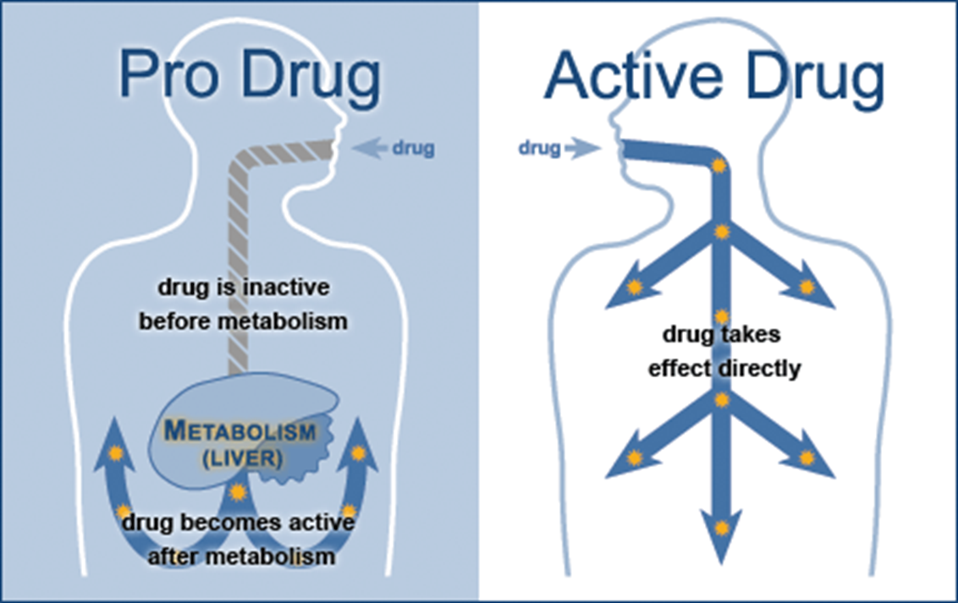
Outcomes of metabolism:
Abolishes activity and terminates drug action
Can promote activity -prodrug–eg, acetylsalicylate
No change in activity –eg, diazepam ---> nordiazepam
Produce toxic metabolites – eg, paracetamol
Notes:
Aspirin is a prodrug, which is transformed into salicylate in the stomach
Paracetamol: N-acetyl –p- benzoquinoneimine (NAPQI)

Slide 64
IV. DRUG CLEARANCE BY THE KIDNEY

Slide 65
Routes of excretion
Main routes of excretion
Renal excretion
Biliary excretion
Others routes of excretion
Exhaled air
Salivary
Sweat
Milk
Tears
Notes:
Metabolites may be excreted in the feces. More commonly, they are reabsorbed into the blood and ultimately excreted in the urine.

Slide 66
Renal excretion

Slide 67
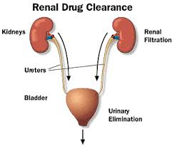
Renal excretion
The main organ for drug excretion is the kidney
The functional unit of the kidney is the nephron
There are three major processes:
Glomerular filtration
Proximal tubular secretion
Distal tubular reabsorption

Slide 68
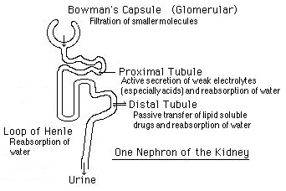
Nephron structure

Slide 69
Physiology of nephron
Notes:
Drugs enter the kidney through renal arteries, which devided to form a glomerular capillaries plexus
Free drugs (not albumin binded) flow through capillary fenestrations into the Bowman’s capsule as part of glomerylar filtrates

Slide 70
Renal elimination of a drug
Elimination of drugs via the kidneys into urine involves the three processes:
Glomerular filtration:
The normal glomerular filtration rate is125 mL/min
Passage of drugs into the glomerular filtrate influenced by:
Glomerular filtration rate
Protein binding of the drugs
No effect of lipophilicity and pH

Slide 71
Proximal tubular secretion:
Secretion in the proximal tubules occurs through active transport:
One for anions (e.g., deprotonated weak acids, A⁻)
One for cations (e.g., protonated weak bases, BH⁺)
They show low specificity
Can transport many compounds
Competition between drugs for these carriers can occur within each transport system.
Example: Penicillins and probenecid
Notes:
Drugs that not transferred into the glomerular filtrate leave the glomerli through efferent arterioles, which divide to form a capillary plexus surrounding the nephric lumen in the proximal tubule
Probenecid is a uricosuric and renal tubular transport blocking agent, It inhibits the tubular reabsorption of urate
Probenecid inhibits the tubular secretion of penicillin and usually increases penicillin plasma levels by any route the antibiotic is given

Slide 72
Note:
Premature infants and neonates have an incompletely developed tubular secretory mechanism
May retain certain drugs in the glomerular filtrate

Slide 73
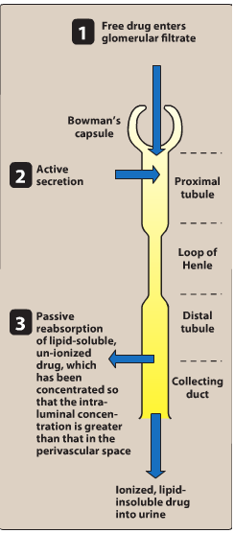

Slide 74
3. Distal tubular reabsorption:
Passive reabsorption of lipid soluble and uncharged drugs
Urine pH affect reabsorption of drugs
Increasing the ionized form of the drug decrease its back-diffusion and increase the clearance of an undesirable drug.
Manipulating the pH of the urine “ion trapping.”
Acidification of the urine increases elimination of weak bases
Alkalinization of the urine increases elimination of weak acids
Notes:
The drug, if uncharged, may diffuse out of the nephric lumen, back into the systemic circulation.
Urine pH 4,5-8

Slide 75
Example:
An overdose of phenobarbital or acetylsalicylic acid(weak acids) can be treated with bicarbonate , which alkalinizes the urine and enhances the excretion of the ionized drug
An overdose of amphetamine (weak base) can be treated with NH₄Cl which acidifies the urine and increase the protonated form of drug (BH⁺) and enhance its renal excretion

Slide 76
Role of drug metabolism:
To minimize this reabsorption, drugs are modified primarily in the liver into more polar substances using two types of reactions:
Phase I reactions which involve either:
the addition of hydroxyl groups or
the removal of blocking groups from hydroxyl, carboxyl, or amino groups
Phase II reactions that use conjugation with
sulfate, glycine, or glucuronic acid to increase drug polarity.
The polar, and the charged molecules cannot back-diffuse out of the kidney lumen

Slide 77
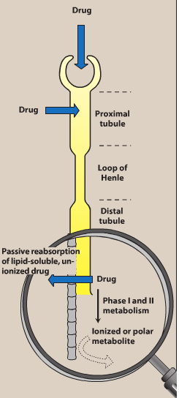

Slide 78
CLEARANCE BY OTHER ROUTES
Other important routes of drug clearance
Intestines
Bile
Lungs
milk in nursing mothers
The feces are primarily involved in elimination of:
Unabsorbed orally ingested drugs
Drugs that are secreted directly into the intestines or in bile.
The lungs are primarily involved in the elimination of:
anesthetic gases (for example, halothane and isofurane).

Slide 79
Elimination of drugs in breast milk:
Considered as a potential source of undesirable side effects to the infant.
Excretion of most drugs into sweat, saliva, tears, hair, and skin occurs only to a small extent

Slide 80
Total body clearance
The total body clearance (CL_{total}): is the sum of the clearances from the various drug-metabolizing and drug-eliminating organs
CL_{total}=CL_{hepatic}+CL_{renal}+CL_{pulmonary}+Cl_{other}
CL_{total} and t_{1/2} are important measures of drug clearance that are used to:
Optimize drug therapy
Minimize toxicity

Slide 81
Renal Clearance
Rate of renal excretion = urine flow x drug concentration in urine
*Example: Rate of urinary excretion of creatinine = 1.3 mg/min
Serum concentration of creatinine = 0.01 mg/ml
CL_{Cr}= 1.3 mg/0.01 mg/ml = 130 ml/min
Notes:
Male: 21ml/sec
Female: 18ml/sec
CL: L/h/kg

Slide 82
Factors altering renal drug clearance
Renal drug clearance is lower therefore you must reduce the dose in:
Elderly and newborn
Women (-20%) than men
Kidney and heart disease
Patients taking drugs which block secretion (aspirin, probenecid, cimetidine)

Slide 83
Drugs excreted mainly by the kidney include:
Aminoglycosides antibiotics (Gentamycin)
Penicillin
Lithium
These drugs are contraindicated in:
Elderly people
Renal disease

Slide 84
Clinical situations resulting in changes in drug half-life
Dose Adjustment is required
When a patient has an abnormality that alters the half-life of a drug
It is important to be able to predict in which patients a drug is likely to have a change in half-life.

Slide 85
The half-life of a drug is increased by :
Diminished renal or hepatic blood flow as: cardiogenic shock, heart failure, or hemorrhage
Decreased ability to extract drug from plasma as seen in renal disease
Decreased metabolism
Another drug inhibits the biotransformation
In hepatic insufficiency, as cirrhosis
Lower doses or less frequent dosing interval may require

Slide 86
The half-life of a drug may decrease by:
1) Increased hepatic blood flow
2) Decreased protein binding
3) Increased metabolism
Higher doses or more frequent dosing interval may require

Slide 87
Dosage Regimens

Slide 88
A dosage regimen:
is defined as the manner in which a drug is taken
An optimal dosage regimen is to:
Maximize benefit of the drug
Minimize adverse effects

Slide 89
To initiate drug therapy a dosage regimen is administrated either by continuous infusion or in intervals of time and dose
The regimen depends on various patients and drug factors, including the rapidly a steady state must be achieved
Steady state: the state at which the rate of administration equals the rate of elimination
The regimen is refined to achieve the optimal dosage regimen

Slide 90
Drug administration
Single dose
Continuous administration
IV infusion
Fixed-dose/fixed-time interval regimens
Notes:
Single dose as in a sleep inducing agent (zolpidem)
1 tab/4hours

Slide 91
Dosage regimens
IV infusion or oral fixed-dose/fixed-time interval regimens
The drug accumulates until a steady state occurs
At steady state the amount of drug administered equals the amount being eliminated
At steady state:
The plasma and tissue levels remain constant with IV infusion and fluctuate around a mean in oral fixed dosage

Slide 92
Plasma concentration of a drug following IV infusion
Following initiation of IV infusion, the plasma concentration of a drug rises until the rate of drug eliminated from the body balances the input rate
steady state is achieved
The plasma concentration of the drug remains constant (1st order elimination)

Slide 93
Influence of the rate of drug infusion on the steady state
The steady state plasma concentration (C_{ss}) is directly proportional to the infusion rate
The C_{ss} is inversely proportional to the clearance of the drug
Hepatic or renal diseases can increase C_{ss}
Increased metabolism decreases C_{ss}
Effect of infusion rate on the steady-state concentration of drug in the plasma. (Ro = rate of infusion of a drug.)
Notes:
factor that decreases clearance, such as liver or kidney disease, increases the steady-state concentration of an infused drug (assuming Vd remains constant). Factors that increase clearance of a drug, such as increased metabolism, decrease the steady-state concentrations of an infused drug

Slide 94
Time required to reach C_{ss}
Notes:
The concentration of drug rises from zero at the start of the infusion to its ultimate steady-state level, Css
The rate constant for attainment of steady state is the rate constant for total body elimination of the drug, ke. Thus, fifty percent of the final steady-state concentration of drug is observed after the time elapsed since the infusion,
Waiting another half-life allows the drug concentration to approach 75 percent of Css .The drug concentration is ninety percent of the final steady-state concentration in 3.3 times t1/2

Slide 95
Fixed-dose/fixed-time-interval regimens
Administration of a drug by fixed doses is more convenient than continuous infusion
Fixed doses administered fixed-time intervals result in fluctuations in drug levels
Fixed dose regimens
Multiple IV injections
Multiple oral administrations

Slide 96
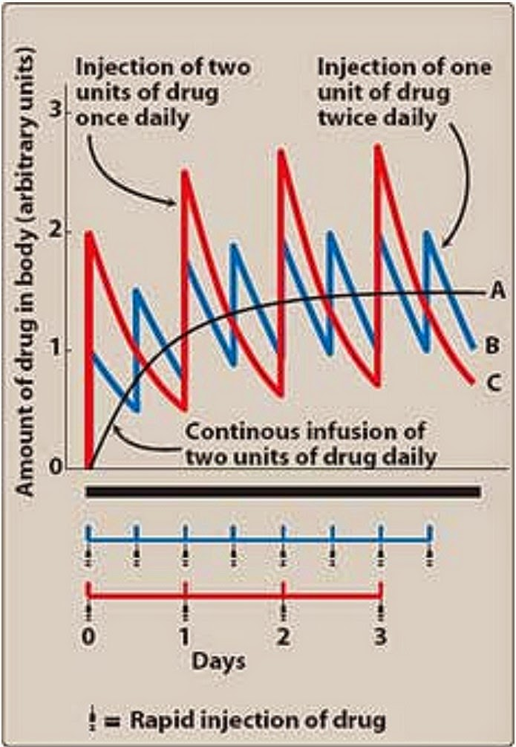
Multiple IV injections
When a drug is given repeatedly at regular intervals, the plasma concentration increases until a steady state is reached
The Using smaller doses at shorter intervals dose not change the at which the steady-state is approached
Notes:
Because most drugs are given at intervals shorter than five half-lives and are eliminated exponentially with time, some drug from the first dose remains in the body at the time that the second dose is administered, and some from the second dose remains at the time that the third dose is given, and so forth. Therefore, the drug accumulates until, within the dosing interval, the rate of drug loss (driven by an elevated plasma concentration) exactly balances the rate of drug administration that is, until a steady state is achieved

Slide 97
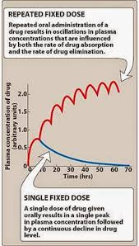
Multiple oral administrations
Orally administered drugs may be absorbed slowly
Plasma concentration of the drug is influenced by
Rate of absorption
Rate of drug elimination

Slide 98
Optimization of dose
The goal of drug therapy is to:
Achieve an maintain concentration within therapeutic window
Minimize toxicity and/or side effects
Drugs of small therapeutic window (e.g., digoxin, warfarin):
Caution should be taken in selecting dosage regimen
Monitoring of drug levels may be needed
Drug regimens are administered as:
Maintenance dose with/without loading dose

Slide 99
Maintenance dose/loading dose
To maintain the plasma concentration within a specified range over long periods of therapy (C_{ss}) maintenance doses is used.
If it is necessary to achieve the target plasma level rapidly, a loading dose is used
Loading dose: is a higher single dose or a series of doses given to achieve the desired plasma level rapidly
Loading dose may be associated with risk of drug toxicity
Notes:
Maintenance dose= target Cplasma x CL/F

Slide 100
Ideally, the dosing plan is based on knowledge of:
Minimum therapeutic level
Minimum toxic concentrations for the drug
Clearance
Vd
Loading dose= (Vd)x (desired C_{ss})/F
For IV:
Loading dose= (Vd)x (desired C_{ss})
Loading dose is usefull for drugs relatively having long t_{1/2}
Notes:
Dosing rate= target C plasma* Cl/F

Slide 102
Therapeutic Window
The therapeutic window is the safe range between the minimum therapeutic concentration and the minimum toxic concentration of a drug.
The concept is used to determine the acceptable range of plasma levels when designing a dosing regimen.

Slide 103
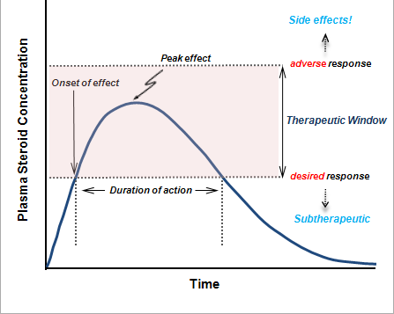
Therapeutic Window

