Slide 1
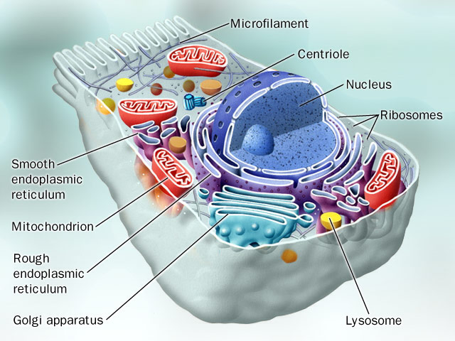
Reversible vs Irreversible cell injury
Al-Quds University
Faculty of Medicine
Pathology Department

Slide 2
reversible injury
necrosis
irreversible injury

Slide 3
MORPHOLOGY- REVERSIBLE INJURY
The ultrastructural changes of reversible cell injury
(1) plasma membrane alterations
(2) mitochondrial changes
(3) dilation of the endoplasmic reticulum
(4) nuclear alterations
Notes:
Cellular swelling is the first manifestation of almost all forms of injury to cells; it appears whenever cells are incapable of maintaining ionic and fluid homeostasis. It can be a difficult morphologic change to appreciate with the light microscope and may be more apparent at the level of the whole organ. When all cells in an organ are affected, there is pallor, increased turgor, and increased weight. Microscopically, small, clear vacuoles may be seen within the cytoplasm; these represent distended and pinched-off segments of the endoplasmic reticulum. This pattern of nonlethal, reversible injury is sometimes called hydropic change or vacuolar degeneration (Fig. 1-21); swelling of cells is reversible.
Fatty change, occurring in hypoxic injury and various forms of toxic or metabolic injury, is manifested by the appearance of lipid vacuoles in the cytoplasm (see Fig. 1-15). It is a less universal reaction, principally encountered in cells participating in fat metabolism (e.g., hepatocytes and myocardial cells), and is also reversible.

Slide 4
Reversible cell injury (Sublethal damage)
Ultrastructural features:
plasma membrane alteration:
blebs, loss of microvilli, loosing of intercellular attachment
mitochondrial alteration
earliest manifestation of sublethal injury
swelling, appearance of phospholipid rich amorphous densities
Notes:
MORPHOLOGYREVERSIBLE INJURY. The ultrastructural changes of reversible cell injury (see Fig. 1-19) include (1) plasma membrane alterations such as blebbing; blunting or distortion of microvilli; and loosening of intercellular attachments; (2) mitochondrial changes such as swelling and the appearance of phospholipid-rich amorphous densities; (3) dilation of the endoplasmic reticulum with detachment of ribosomes and dissociation of polysomes; and (4) nuclear alterations, with disaggregation of granular and fibrillar elements.Two patterns of morphologic change correlating to reversible injury can be recognized under the light microscope: cellular swelling and fatty change.Cellular swelling is the first manifestation of almost all forms of injury to cells; it appears whenever cells are incapable of maintaining ionic and fluid homeostasis. It can be a difficult morphologic change to appreciate with the light microscope and may be more apparent at the level of the whole organ. When all cells in an organ are affected, there is pallor, increased turgor, and increased weight. Microscopically, small, clear vacuoles may be seen within the cytoplasm; these represent distended and pinched-off segments of the endoplasmic reticulum. This pattern of nonlethal, reversible injury is sometimes called hydropic change or vacuolar degeneration (Fig. 1-21); swelling of cells is reversible.Fatty change, occurring in hypoxic injury and various forms of toxic or metabolic injury, is manifested by the appearance of lipid vacuoles in the cytoplasm (see Fig. 1-15). It is a less universal reaction, principally encountered in cells participating in fat metabolism (e.g., hepatocytes and myocardial cells), and is also reversible.

Slide 5
Reversible cell injury
dilation of endoplasmic reticulum
loss of the ribosomes
nuclear alteration
clumping of nuclear chromatin

Slide 6
MORPHOLOGY- REVERSIBLE INJURY
Two patterns of morphologic change can be recognized under the light microscope:
Cellular swelling
Fatty change
Notes:
Cellular swelling is the first manifestation of almost all forms of injury to cells; it appears whenever cells are incapable of maintaining ionic and fluid homeostasis. It can be a difficult morphologic change to appreciate with the light microscope and may be more apparent at the level of the whole organ. When all cells in an organ are affected, there is pallor, increased turgor, and increased weight. Microscopically, small, clear vacuoles may be seen within the cytoplasm; these represent distended and pinched-off segments of the endoplasmic reticulum. This pattern of nonlethal, reversible injury is sometimes called hydropic change or vacuolar degeneration (Fig. 1-21); swelling of cells is reversible.
Fatty change, occurring in hypoxic injury and various forms of toxic or metabolic injury, is manifested by the appearance of lipid vacuoles in the cytoplasm (see Fig. 1-15). It is a less universal reaction, principally encountered in cells participating in fat metabolism (e.g., hepatocytes and myocardial cells), and is also reversible.

Slide 7
Reversible cell changes
Cell swelling
Called hydropic changes or vacuolar degeneration
universal to all cell types
loss of ionic and fluid homoeostasis
cells show clear vacuoles in the cytoplasm
distended and pinched-off segments of ER
Notes:
Cellular swelling is the first manifestation of almost all forms of injury to cells; it appears whenever cells are incapable of maintaining ionic and fluid homeostasis. It can be a difficult morphologic change to appreciate with the light microscope and may be more apparent at the level of the whole organ. When all cells in an organ are affected, there is pallor, increased turgor, and increased weight. Microscopically, small, clear vacuoles may be seen within the cytoplasm; these represent distended and pinched-off segments of the endoplasmic reticulum. This pattern of nonlethal, reversible injury is sometimes called hydropic change or vacuolar degeneration (Fig. 1-21); swelling of cells is reversible.
Fatty change, occurring in hypoxic injury and various forms of toxic or metabolic injury, is manifested by the appearance of lipid vacuoles in the cytoplasm (see Fig. 1-15). It is a less universal reaction, principally encountered in cells participating in fat metabolism (e.g., hepatocytes and myocardial cells), and is also reversible.

Slide 8
Reversible cell changes
Fatty changes:
Specific to cells dealing with fat metabolism, liver and heart
Lipid vacuoles in the cytoplasm

Slide 9
Reversible cell changes
Macroscopic changes; gross features:
increase in the weight of the organ
pallor of the organ

Slide 10
Types of cell injury
(Lethal injury)
irreversible injury

Slide 11
Irreversible cell injury (lethal damage)
General pathways:
excessive damage to all membranes, cytosolic and organelles
Calcium is a potential mediator of irreversible cell death. Increase intracellular Ca content from the extracellular compartments, with activation of the different enzymes

Slide 13
Irreversible cell injury
Leakage of digestive enzymes from lysosomes. With the low pH, hydrolases are activated. They begin to digest the cell components.
Autolysis: if the cells are digested by their own enzymes
Heterolysis: if the cells are digested by lysosomes from other cells

Slide 14
Irreversible cell injury
Functional changes typically precede any morphologic changes of cell injury
These processes require hours to develop, and so there are no detectable changes in cells if, e.g., a myocardial infarct causes sudden death.
most necrotic cells and their debris disappear by a combined process of extracellular enzyme digestion and leukocyte phagocytosis.
If necrotic cells and cellular debris are not promptly eliminated, they tend to attract calcium salts and other minerals and undergo dystrophic calcification

Slide 15
Mechanisms of irreversible injury
Two phenomena characterize irreversibility:
Inability to reverse mitochondrial dysfunction
Development of severe membrane damage
This is the VITAL step at which “No Return”
Notes:
Mechanisms of Irreversible Injury The biochemical sequence of events associated with cell injury were described earlier as a continuum from onset to ultimate digestion of the lethally injured cell by lysosomal enzymes. However, where was the "point of no return" beyond which the cell was irretrievably doomed to destruction? And when did the cell actually die? Two phenomena consistently characterize irreversibility. The first is the inability to reverse mitochondrial dysfunction (lack of oxidative phosphorylation and ATP generation) even after resolution of the original injury (e.g., restoration of blood flow). The second is the development of profound disturbances in membrane function. Although the depletion of ATP in itself might constitute a lethal event, the evidence is conflicting; it has been possible experimentally to dissociate the morphologic changes, as well as ATP depletion, from the inevitability of cell death.

Slide 16
Irreversible cell injury: mechanism
Cell membrane damage:
Progressive loss of membrane phospholipids.
By activation of phospholipases by Ca, and decrease synthesis of proteins
Cytoskeletal abnormalities.
Loss of the filaments between the cytoplasm and the cell membrane. So the cell membrane becomes loose and susceptible to rupture.
Toxic oxygen radicals.
This leads to peroxidation of the membranes.
Lipid breakdown products.
These act as detergents on the membranes.
Notes:
Mechanisms of Irreversible Injury The biochemical sequence of events associated with cell injury were described earlier as a continuum from onset to ultimate digestion of the lethally injured cell by lysosomal enzymes. However, where was the "point of no return" beyond which the cell was irretrievably doomed to destruction? And when did the cell actually die? Two phenomena consistently characterize irreversibility. The first is the inability to reverse mitochondrial dysfunction (lack of oxidative phosphorylation and ATP generation) even after resolution of the original injury (e.g., restoration of blood flow). The second is the development of profound disturbances in membrane function. Although the depletion of ATP in itself might constitute a lethal event, the evidence is conflicting; it has been possible experimentally to dissociate the morphologic changes, as well as ATP depletion, from the inevitability of cell death. Figure 1-20 Mechanisms of membrane damage in ischemia (see text).page 23 page 24Considerable evidence favors cell membrane damage as a central factor in the pathogenesis of irreversible cell injury. Loss of volume regulation, increased permeability to extracellular molecules, and demonstrable plasma membrane ultrastructural defects occur even in the earliest stages of irreversible injury. There are several potential causes of membrane damage, and all may play a role in certain forms of injury (Fig. 1-20).
Progressive loss of membrane phospholipids. In ischemic liver, irreversible injury is associated with a marked decrease in membrane phospholipids. One explanation may be increased degradation due to activation of endogenous phospholipases by ischemia-induced increases in cytosolic calcium. Progressive phospholipid loss can also occur secondary to decreased ATP-dependent reacylation or diminished de novo synthesis of phospholipids.
Cytoskeletal abnormalities. Activation of proteases by increased intracellular calcium may result in damage to the cytoskeleton. In the setting of cell swelling, such injury may cause detachment of the cell membrane from the cytoskeleton, rendering the membrane susceptible to stretching and rupture.
Toxic oxygen radicals. Partially reduced oxygen species are highly toxic and cause injury to cell membranes and other cellular constituents. Such oxygen radicals are increased in ischemic tissues, particularly after restoration of blood flow by recruitment of leukocytes and other mechanisms discussed in the section "Ischemia/Reperfusion Injury."
Lipid breakdown products. These catabolic products accumulate in ischemic cells as a result of phospholipid degradation and have a detergent effect on membranes.

Slide 17
Cell membrane damage

Slide 18
Irreversible cell injury: mechanism
mitochondrial dysfunction
One of the earliest manifestations of irreversible cell injury is the vacuolization of the mitochondria, and the accumulation of amorphous, calcium-rich densities in mitochondrial matrix
Affect the oxidative Phosphorylation, decrease ATP

Slide 19
Morphology of irreversible cell injury: Necrosis
The morphological correlate of irreversible cell injury
Defined as the sequence of morphological changes that follows cell death in living tissue
These morphological changes require hours to develop.

Slide 20
Necrosis
morphological changes are the result of:
1- enzymatic digestion of the cell
* by lysosomal enzymes:
- autolysis. - heterolysis.
➔ Leakage of proteins and cellular constituents e.g:
Cardiac muscle: creatine kinase & troponins.
Liver: alkaline phosphatase.
2- denaturation of proteins

Slide 21
Ultrastructural morphological changes: Necrosis
Defects in cell membrane
Mitochondrial swelling and large densities
Swelling of the ER and detachment of ribosomes
Appearance of myelin figures
Rupture of lysosomes

Slide 22
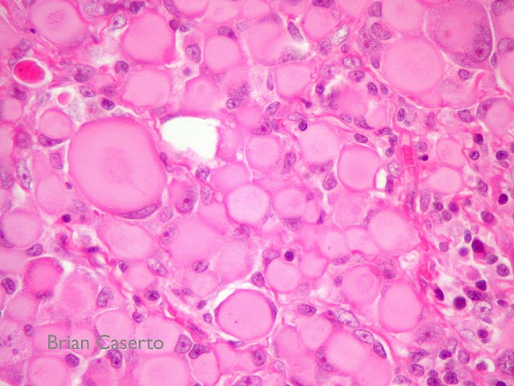
Necrosis: Light microscopic features
Acidophilia: pink staining from the eosin dye: "E" in H & E.
Basophilia: blue staining from hematoxylin dye: "H" in H & E
Changes in the cytoplasm in Necrosis:
acidophilia of the cytoplasm (pink staining)
binding of eosins to denatured proteins
loss of basophilia from the loss of RNA
glassy cytoplasm: loss of glycogen
vacuolated cytoplasm: degeneration of organelles
calcification of cells
Notes:
MORPHOLOGY: Dead cells show increased eosinophilia (i.e., pink staining from the eosin dye: the "E" in "H & E"). This is attributable in part to increased binding of eosin to denatured intracytoplasmic proteins, and in part to loss of the basophilia that is normally imparted by the RNA in the cytoplasm (basophilia is the blue staining from the hematoxylin dye: the "H" in "H & E"). The cell may have a more glassy homogeneous appearance than viable cells, due mainly to the loss of glycogen particles. When enzymes have degraded the organelles, the cytoplasm becomes vacuolated and appears moth-eaten. Finally, calcification of the dead cells may occur.

Slide 23
Light microscopic features
Changes in the nucleus in Necrosis:
Pyknosis: increased basophilia due to shrinkage of the nucleus
Karyorrhexis: fragmentation of the pyknotic nucleus by nucleases
Karyolysis: loss of the basophilia of the chromatin, secondary to DNAase activity.
1-2 days following death, the nucleus disappears completely
Karyolysis

Slide 24
Types of cell injury: summary

