Slide 1
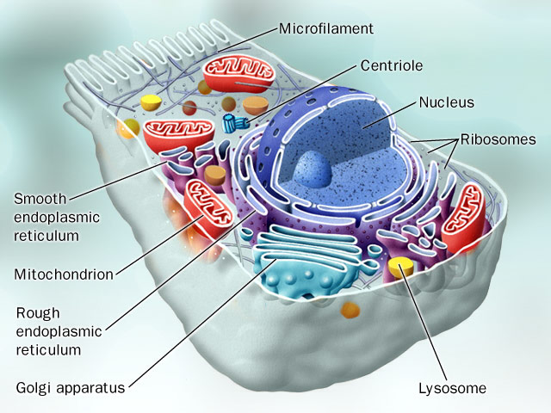
Subcellular Responses to Injury
Al-Quds University
Faculty of Medicine
Pathology Department

Slide 2
Subcellular responses to injury
Lysosomal Catabolism
Heterophagy
Autophagy
Induction (Hypertrophy) of Smooth
Endoplasmic Reticulum
Mitochondrial Alterations
Cytoskeletal Abnormalities
Heat Shock Proteins

Slide 3
Subcellular responses to injury:
Lysosomal catabolism:
Primary lysosomes: membrane bound intracellular organelles containing a variety of hydrolytic enzymes
Secondary lysosomes, “phagolysosome” : when the primary lysosomes fuse with vacuoles containing material for digestion.

Slide 4
1. Lysosomal catabolism:
Two ways:
autophagy
heterophagy

Slide 5
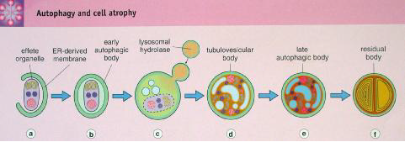
Type of phagocytosis:
Autophagy:
When intracellular organelles are sequestered from the cytoplasm in an autophagic vacuole. This combines with primary lysosome to form autophagolysosome.
seen especially with atrophy and aging.

Slide 6
Type of phagocytosis:
Heterophagy:
Inflammatory cells engulf and destroy foreign
bodies
e.g. bacteria are ingested and degraded by neutrophils
e.g. macrophages engulf and catabolize necrotic cells.
Pinocytosis: is engulfment of soluble small material
Phagocytosis: engulfment of large material

Slide 7
Type of phagocytosis:
Lysosomes can completely catabolize most proteins and carbohydrates
Lysosomes with undigested debris may persist within cells as residual bodies or may be extruded
Lipofuscin pigment granules represent indigestible material resulting from intracellular lipid peroxidation, and certain indigestible pigments, such as carbon particles inhaled from the atmosphere or inoculated pigment in tattoos, can persist in phagolysosomes of macrophages for decades

Slide 8
2. Hypertrophy of the smooth endoplasmic reticulum:
Stimulation and activation of SER and its enzymes (P-450 oxidase) to increase the solubility and excretion of various compounds, like drugs.
Increase solubility of drugs (e.g., steroids, alcohol, aryl hydrocarbons, insecticides) and thereby facilitate their excretion.
E.g. patients who increase their alcohol intake while taking phenobarbital for epilepsy may end up with subtherapeutic levels.

Slide 9
3. Mitochondrial alternations:
Increase number in hypertrophy
Decrease number in atrophy
Example: alcoholic liver disease
– large and abnormal shapes (megamitochondria)

Slide 10
4. Cytoskeletal abnormalities
Increase or decrease with hypertrophy or atrophy
functional modification to withstand more stress.
e.g. immobilizing cilia of the respiratory epithelium, resulting in chronic infections due to defective clearance of inhaled bacteria (Kartagener, or the immotile cilia syndrome).
Microtubules are essential for leukocyte migration and phagocytosis.
e.g. Drugs that prevent microtubule polymerization (colchicine)
are therefore useful in treating gout, in which symptoms are due
to movement of macrophages toward urate crystals with
subsequent frustrated attempts at phagocytosis.

Slide 11
5. Heat shock proteins; HSP
Synonymous: stress proteins, molecular
chaperones
Cytoplasmic proteins that are involved in protein kinesis and repair, like protein folding, transport and disaggregation.
Important adaptive response found in all species

Slide 12
Heat shock proteins; HSP
Two families:
Produced always at low levels; HSP 60, 90
Produce under stress; HSP 70
HSP induced after injurious stimuli leads:
Refolding denatured proteins before causing
death.
If not responding, the protein is directed to bind with ubiquitin-proteasome pathway, leading to degradation.

Slide 13
Heat Shock Proteins; HSP

